Slide 1
Community Activism: Voting & Census 2020
Presenters:
Kendrick Roberson, Chair YOUNG Committee
Torre White, Co-Chair YOUNG Committee
Janet Constance, District 9 YOUNG Coordinator
Revised 2/2020
Notes:
This brief was created and provided by Danielle. Kendrick Roberson edited the deck for the purposes of YOUNG Community Activism: Voting/ Census 2020 training on Feb 9, 2020.

Slide 2
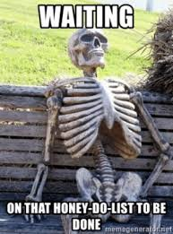
AGENDA aka HONEY DO LIST…
CENSUS 2020
THE VOTER & THE ELECTION
CONSTITUENCY/
COMMUNITY ENGAGEMENT

Slide 3
CENSUS 2020
#AFGECOUNTS

Slide 4
CENSUS FACTS
Occurs every ten years
Started in 1790 and is required by the
Constitution
Is a tool used to count every person living in the country
Allocates federal funding in states
Determines changes to congressional apportionment in states (i.e., redistricting) testing, and public engagement occur every single year

Slide 5
What is on the Census & How Safe is it?
Short questions, including:
Age
Race and Hispanic Origin
Relationship Status in Household
Homeownership (Owner/Renter)
Telephone Number
Information on additional people living in the home
No Citizenship Question in 2020
Confidentiality measures have become more important with the addition of a citizenship question
Information provided on a census form is kept confidential
Under Title 13, Census Bureau workers are prohibited from sharing any collected information

Slide 7
THE UNDER COUNTED…
Multi-Generational Households
•Households with more than 7 people
•Low-income
•People with mental or physical disabilities
•Renters
•33% of the total U.S. population
•Young Children
•Cultural and Linguistic Minorities
•Racial and Ethnic Minorities
•Households with Undocumented Immigrants and Recent Immigrants
•Hispanic Immigrants and their Children

Slide 8
Let’s Do This…
Start talking about the Census with your members and allies
Lend your voice through sign-on letters, federal and state advocacy
Partner w/ Community Organizations to Establish local Complete Count Committees in hard-to-count communities
Recruit business leaders, elected officials, and other CBOs
Host events to educate community members about the 2020 Census. Use digital tools to reach undercounted areas: Utilize your new hall as a Census Clinic to build relationships w/ members, their families and the community and to assist them in the Census process.
Eg: SMS programs, data targeting, advertising, social media
Share Census Bureau job postings and encourage members of the community to apply
Create a strategic plan

Slide 10
Mark Your Calendar
)

Slide 11
THE VOTER & THE ELECTION
“The Soap Opera of Voter Registration, Education, Mobilization”

Slide 12
Let’s Exercise… What Is It????
Voter Registration is…
Voter Educations is…
Voter Mobilization is…
Voter Accountability is…
(15 Exercise)

Slide 13
Things to Know
Voter Registration Deadlines
Early Voting, Primary, General & Special Election Dates
Local Polling Places & Times
The Phone Number, Venue, Hours of Operation & Director of your Local Board of Elections
The Monthly Meeting of Your Local Board of Elections
Create an Issue-Based Platform Based on your Members
Who is on the Ballot & What They Stand For
Suppressive Laws such as Voter ID, Gerrymandering,
Pre-registration, etc.
Types of Ballots: Election, Provisional, Absentee

Slide 14
Give Your Members Something to Do…
Canvassing, Phone Banking, Texting
Social Media
Creative Days of Action
Poll Monitors
Rides to the Polls Drivers
Poll/Watch Parties for Members & Their Families
Voter Registration/Commitments
Membership Issue Based Forums w/ Politicians
Assign Members to Participate in Local Meetings, Forums, Debates, Board of Elections Meetings, etc.
Encourage Members to be Involved in Community Organizations. Groups, Local CLC initiatives, etc.

Slide 15
How to Engage Members…
Understand that voting goes beyond the registration form and the ballot
Work with community groups, organizations and schools to ensure your members and their families are registered
Respect the Voter; however educate them on the issues that affect labor
Utilize your hall… create relationships with your members… it makes it easier to engage in conversation around issue based voting
Look at every moment as an opportunity: a new member could be a new voter; a new E-Dues member could be an updated voter registration
Don’t forget about your member’s family: spouse, age appropriate children
Don’t miss moments to educate: Membership, Voter Registration; Polling Places/Times, etc.
Don’t miss the opportunities to mobilize: Set up rides to the polls; Create voter engagement flyers for members; etc.

Slide 16
CONSTITUENCY/ COMMUNITY ENGAGEMENT
“We Are All In This Movement Together”

Slide 22
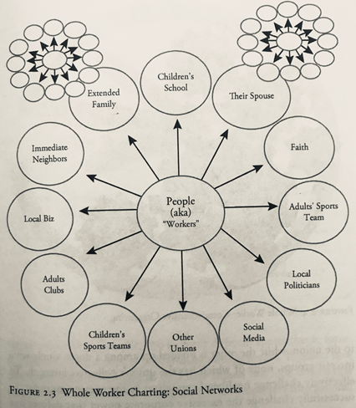
“ WE THE PEOPLE WORKER MEMBER…”
What is your membership strategy???

Slide 23
References…
https://uaw.org/standing-committees/civil-human-rights-committee/resource-links-civil-human-rights/
https://aflcio.org/about-us/our-unions-and-allies
https://www.macmillandictionary.com/us/dictionary/american/constituency
https://www.census.gov/library/visualizations/2019/comm/2020-everyone.html
census@calaborfed.org

