Slide 1
AFGE Council 238 Communications Training
June 13, 2018

Slide 2
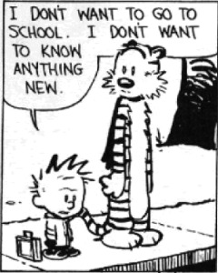
What Are Three Goals You Have for Today?

Slide 3
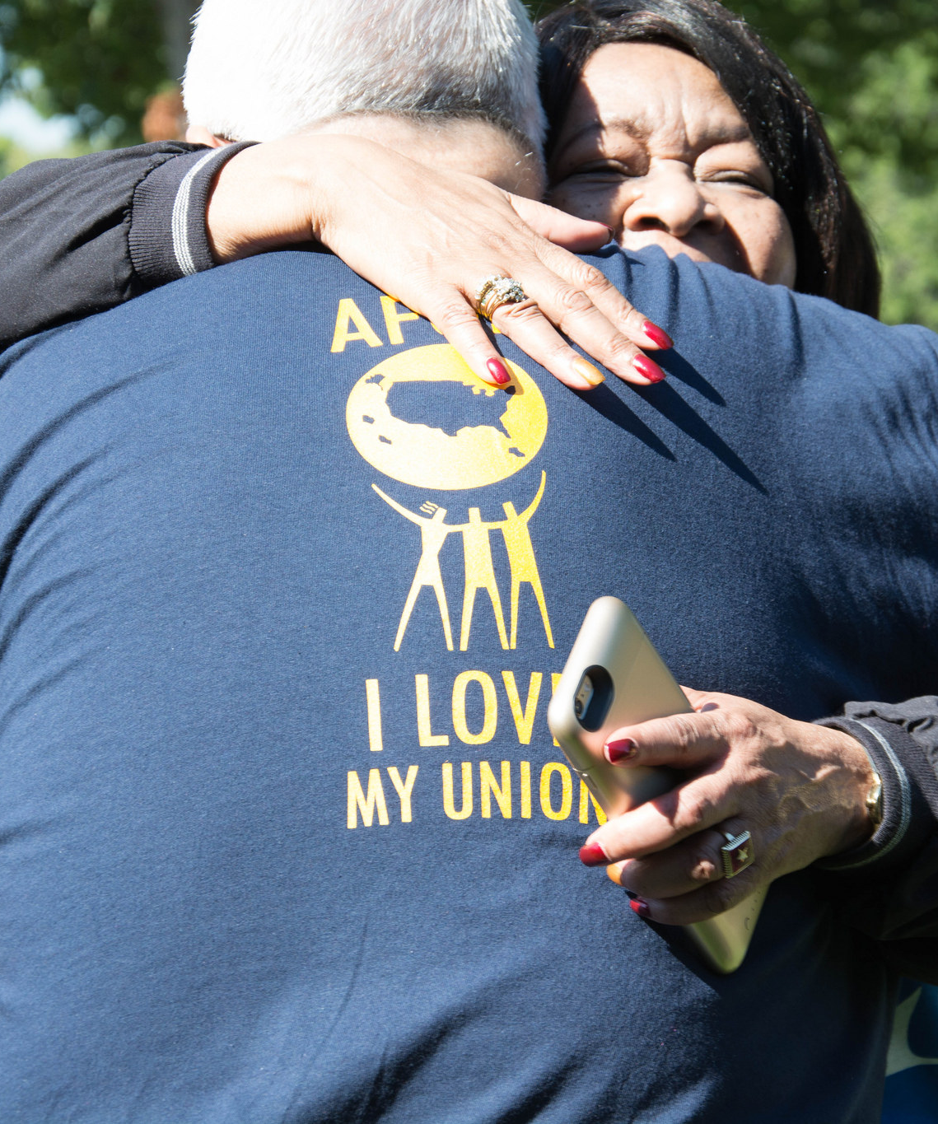
Today’s Agenda
Meet the team
How to write engaging content
Pitching to the press
How to conduct an interview
Multimedia and its use
Social media
Press conferences
238’s Plan Going Forward

Slide 4
Meet the Communications Team
“
Mission: Provide timely and effective information and resources to educate, engage, and empower the AFGE membership and the public in support of our Federation’s vision.
”
Three Main Roles:
Public Relations
Internal Communications
Digital Mobilization

Slide 5
Communications Department Staff
Ashley De Smeth, Director
Oversees dept. staff, assignments and strategic planning
Andrew Huddleston, Deputy Director
Assists with execution of AFGE and Comms director priorities and facilitates project coordination'
Donnell Owens, Secretary
Handles department administrative needs
Sydney Glass, Comms Specialist
Coordinates TSA Council media outreach and manages social media platforms
Ursula Lauriston, Comms Specialist
Coordinates and develops print publications; and internal marketing
Chelsea Bland, Comms Specialist
Coordinates NVAC media outreach, federation photography and dept. trainings
Tichakorn Hill, Writer
Coordinates and develops AFGE’s Week in Review, AFGE Leader, assists with other internal publications
Alex Palombo, Comms Specialist
Coordinates CPL media outreach, develops email communication to members and manages texting program
Tim Kauffman, Comms Specialist
Coordinates media outreach for DEFCON, legislative and government pay & benefit issues
Jason Roe, Comms Specialist
Coordinates and develops AFGE video products
Dan Riehl, Comms Specialist
Maintains AFGE microsites, national website and assists locals/councils districts with creating websites
Cheston McGuire, Press Secretary
Coordinates media outreach for AFGE, writes and places op-eds and letters to the editor, writes and distributes press releases

Slide 6
Writing Articles and Related Content That Engage Your Audience

Slide 7
Before Writing Anything, Answer These Questions:
Does my potential audience care about my topic?
What values can I tap into to make this piece persuasive and/or relatable?
How can I make this skimmable such that the most important information is easily understood?
How can it be designed to succeed across web, mobile, social, etc.?
What other content have we produced that could be linked or embedded here to increase stickiness?
What headline would make we want to read what I’m writing?
What opening line will make me want to read more?

Slide 8
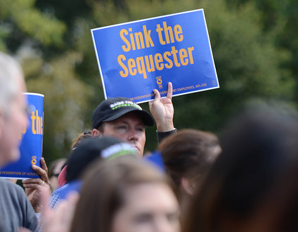
Writing Engaging Content
1
NEWS YOU CAN USE
Know your audience
Explain the relevance
Who, what, when, why, and where
Call to action
GRAB THE READER’S ATTENTION
Write catchy headlines
Keep articles short
Be visually appealing
Don’t reinvent the wheel
2

Slide 9
Good Examples of Headlines and Intros:
‘This storm will kill you’: Hurricane Matthew strengthens to Category 4
The strongest storm system to threaten the U.S. in a decade roared toward landfall with Florida. More than 2.5 million people were under evacuation orders from Florida to South Carolina. Florida Gov. Rick Scott warned: "Time is running out.”
In New York, You Can Now Be Buried Alongside Your Pet
A new law in New York State allows pets to be buried next to their owners in cemeteries meant for people.
Snapchat Working on an IPO Valuing Firm at $25 Billion
Snapchat’s parent, Snap, is working on an initial public offering that could value the popular virtual-messaging company at $25 billion or more, in what would be one of the highest-profile debuts in years.

Slide 10
What Should I Be Writing?
Press Release
Media Advisory
Op-Ed or Guest Column
Web Article
Social Media Post

Slide 11
Rules for Writing
Before Writing Anything, Answer These Questions:
What values can I tap into to make this piece persuasive/relatable?
How can I make this skimmable such that the most important information is easily understood?
How can it be designed to succeed across web, mobile, social, etc.?
What other content have we produced that could be linked/embedded here to increase stickiness?
What headline would make we want to read what I’m writing?
What opening line will make me want to read more?
After Writing Anything, Answer These Questions:
Has this piece been thoroughly vetted for grammatical and factual accuracy? If there is an opportunity to cite your sources, please do so with endnotes or hyperlinks.
Who needs to review this piece, and when do they need to review it in order to meet its publication deadline?

Slide 12
What Makes a Great Op-Ed?
Who is your audience?
Members
Labor/Progressive
Federal Government Communities
Public
Decision Makers
What will make this issue most interesting to them? Think about what the audience values.
Tailor your title for ultimate clickability in your given audience
Hook your readers with a salient, value-oriented opening line
Establish your opinion or arguments (and your adversary’s)
Proof Points- facts, anecdotes that support your argument or refute your adversary’s
Close the argument- summary of argument, but keep it value-oriented. Include Call To Action if publication allows.

Slide 13
How to Write for the Web
Fonts
Use an easy-to-read size, usually 10 or 12 points, for the text of web or blog posts. Headlines should be larger – 18 points or more.
Use easy-to-read fonts, such as Arial, Times New Roman, Courier or Georgia. Steer clear of funky, decorative or stylish fonts.
Limit the number of different fonts you use. You can use one font for headlines and another for the text of posts, but try not to use more than three different fonts in a single blog or web post.
Use font styles such as italics, boldface and underlining sparingly. They can help call attention to certain parts of a post, but using too many styles defeats the purpose.
Layout and design
Use lists to outline steps in a process, action items or tasks that need to be checked off. Introduce a list with an independent clause, followed by a colon. Use bullets or dashes to draw readers’ eyes to each list. Here’s an example:
Bullets break up the text on a page.
Keep them short and to the point.
Limit each list to three or four items.
Supplement your writing with visuals such as photos or clip art. However, avoid overloading your blog/website with too many visuals.

Slide 14
How to Write for the Web Continued
The Write Stuff
The “inverted pyramid”
The most important information goes at the top of the post, while less important details or supporting sentences go at the end.
Even if readers only read the first paragraph, you’ve given them the most important information and familiarized them with the topic.
Write strong headlines that grab the reader’s attention
An effective headline summarizes your main point in a few words
Use the active, present tense voice
Use a strong verb to convey action
Example:
NO. Workers gathered at rally to protest contracting out proposals
YES! Workers rally against contracting out
Web posts should be easy to read and understand
Write in a conversational tone. Try reading aloud what you are writing. If you stumble over your words, then the reader might get lost too.
Translate the jargon. Ask yourself: Would someone outside of your agency understand what you’re writing? If not, then it’s too confusing.

Slide 15
How to Write for the Web Continued
Don’t stray from the facts
When you’re writing a post about an event or issue, stick to the facts. You don’t have to source everything you write, but make sure you can back it up.
If you’re writing an opinion piece or posting a letter from the local president, use a sectional headline such as “Editorial” or “President’s Letter” to set it off from news articles.
Don’t plagiarize
Get permission to repost material from other websites, newspapers or magazines.
If you summarize another person’s work, simply credit the source.
Edit, edit, edit!
Always edit your work before posting.
Run a spell check and grammar check to pick up commonly misspelled words or awkward phrases, but don’t rely on spell check alone.
Read your work out loud. This forces you to read each word individually and increases the chance you’ll pick up any errors.
Double check every detail. If you provide hyperlinks to websites, make sure the links work.

Slide 16
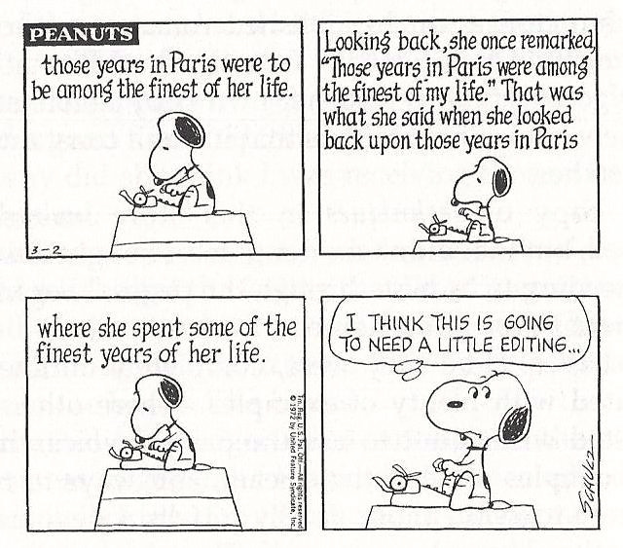
Tools To Improve Your Writing
Proofing Your Text – www.grammarly.com
Grading Your Writing – www.hemingwayapp.com
Word Counter – www.wordcounter.com
Word Finder – www.thesaurus.com

Slide 17
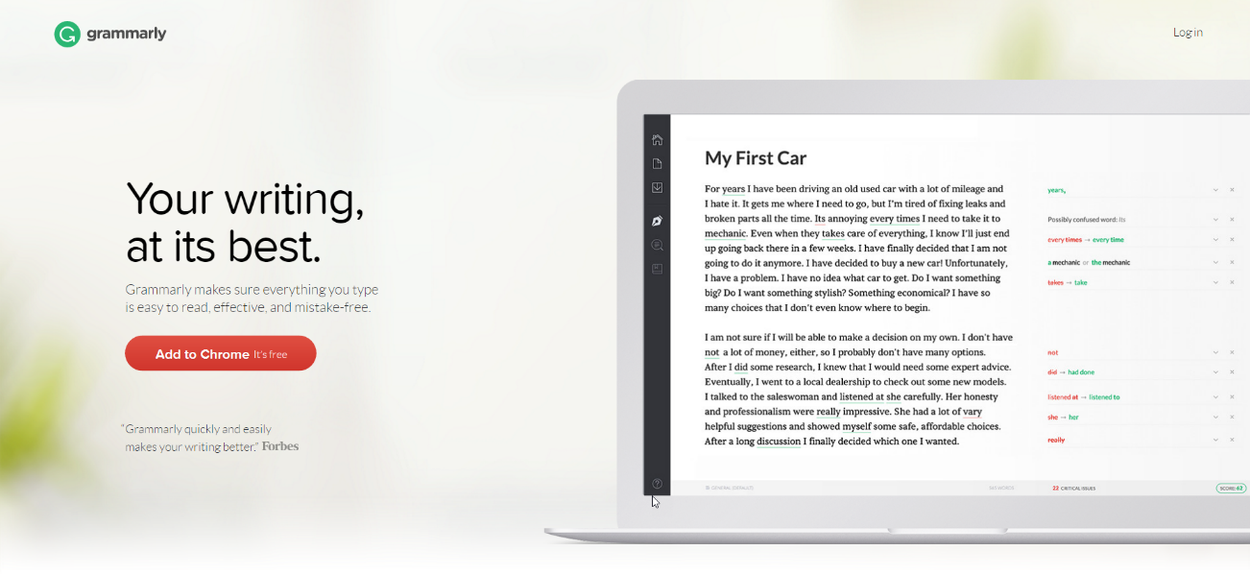
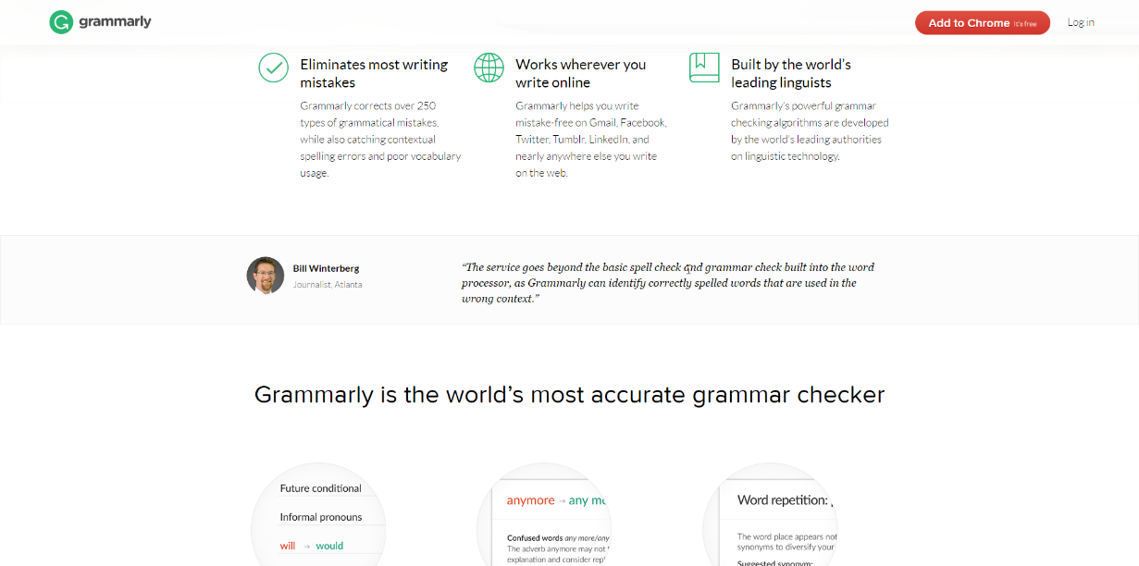
Proofing
Proofing your work is vital to its credibility, readability, sharability, and pitchability
There are free tools outside of Microsoft Word that help
For example: www.grammarly.com

Slide 18
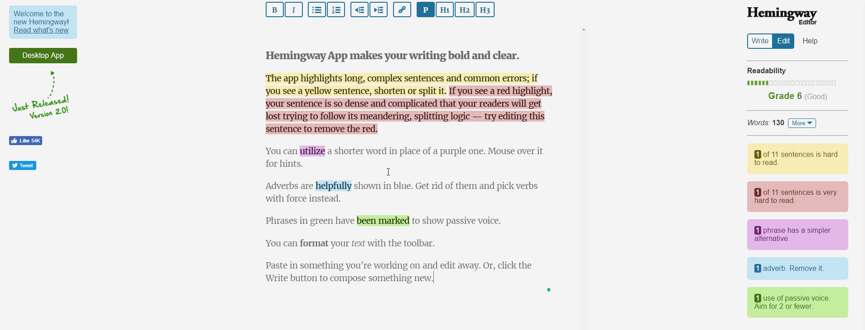
Grading Your Writing
All stories must be written at an 8th grade level – keep the verbiage and subject matter as simple as possible
Use www.hemingwayapp.com to check what grade level your writing is

Slide 19
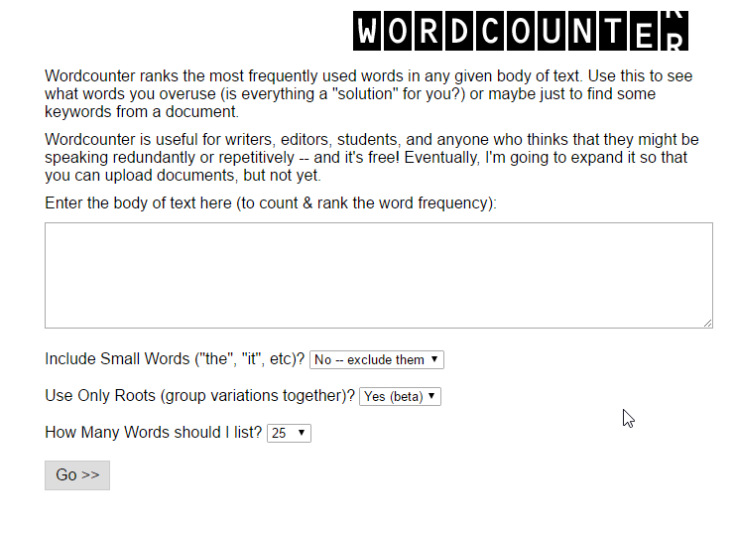
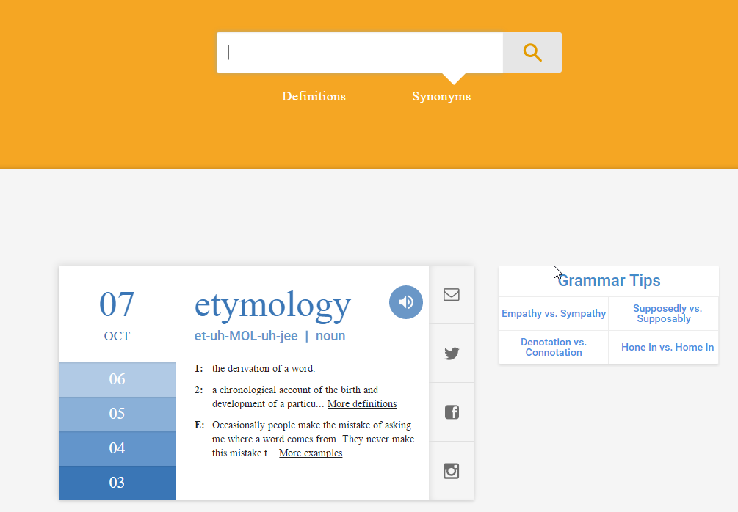
Making Sure You Use the Write Words
Readers and editors don’t want to see the same words over and over again
Sometimes it’s hard to see you’re doing that when dealing with Union issues that have specific terms
Use www.wordcounter.com to see if you’re overusing certain words
Use www.thesaurus.com to find alternative words

Slide 20
Resources Available at www.AFGE.org
RESOURCES AT YOUR FINGERTIPS
Press Releases
News articles
Issue Papers
Talking Points
Logos and other visuals
Photos on www.flickr.com/afge

Slide 21
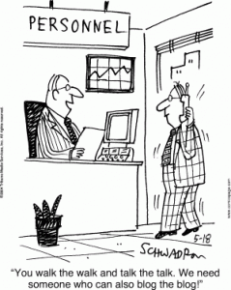
What is an Example of an Op-Ed You’d Like to Write?
Pick a topic you think would make for a good Op-Ed
Who is your audience?
Members
Labor/Progressive
Federal Government Communities
Public
Decision Makers
Write the proposed headline
Write your lead/introduction
Where would you want to pitch it?

Slide 22
Rules to Remember
Everything you write should tie back into your core mission: to elevate the voices of government employees who deliver vital services to the public.
You are not reporters, you are columnists. You’re not just describing what happened, we are giving meaning to it
Spend as much time nailing the headline and opening paragraph as you spend on the entire rest of the story. If you don’t get those right, no one will read the rest anyway.
Avoid the passive voice, legislativese, legalese, and unionese – we want to be action-oriented and crystal clear.

Slide 23
Pitching to the Press

Slide 24
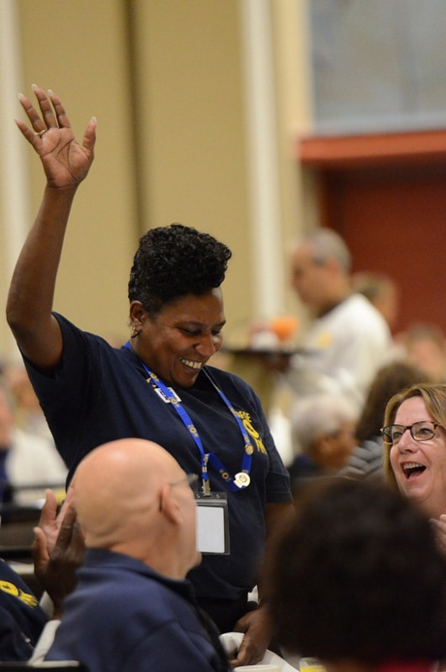
When you pitch a story to the press, the first thing you need to ask is, “Who cares?”
Then, you should determine:
What are you aiming to get out of this news item?
Is it newsworthy?
Is there a national angle you can tie-in?
Will there be any potential fall-out?
Knowing all that, is it still worth pitching?
Notes:
The full results: http://googlepolitics.blogspot.com/2015/06/understanding-americas-interested.html?m=1

Slide 25
What do the Pros Say?

Slide 26
GENERATING PRESS COVERAGE
THINK LIKE A REPORTER
Specify the 5 Ws
Who
What
Where
When
Why
Explain the news value
Offer one-on-one interviews
Target the right reporters
Do their research for them
Do you have documentation you can share?

Slide 27
Example: Save the VA Rallies and the Charlotte Observer
Received this email from a Local in North Carolina who wanted the Charlotte Observer to cover a rally:
Hung up on by Mr. Ronnie Glassburg
Spoke with another editor that questioned me being hung up on and basically agreed with Mr. Glassburg's comment: "This is not a NC issue. This is federal."
How do you overcome that?

Slide 28
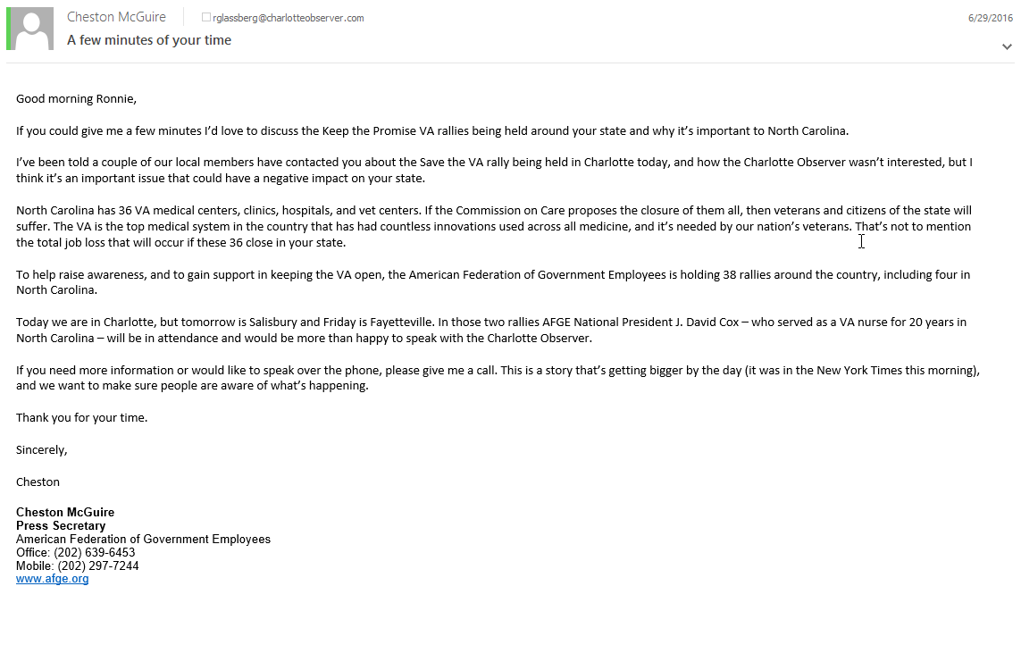
Example: Save the VA Rallies and the Charlotte Observer Continued

Slide 29
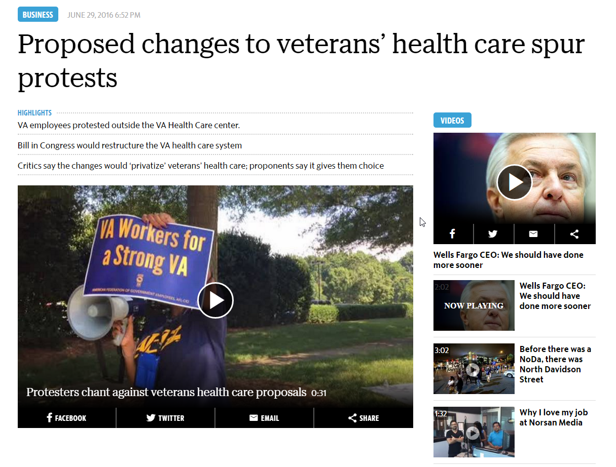
Example: Save the VA Rallies and the Charlotte Observer Continued

Slide 30
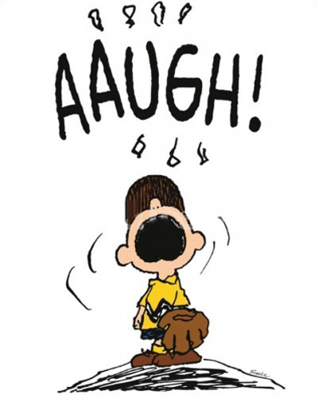
How Can You Find Reporters and Editors to Pitch?
Search through your local media to find reporters who would cover your story
Even when not pitching it’s helpful to find ways to connect with them so they can be a future resource
Find articles that talk about what your pitching so you can offer a counterpoint
Follow the national narrative (if it applies) to ensure your pitch is in line
Connect with reporters on Social Media

Slide 31
Writing the Email
Subject line matters. It’s your first and best chance to be noticed
Use a site like www.subjectline.com to test yours
Make sure the email is coming from a source they can trust
Example: Using Cheston.McGuire@gmail.com instead of DCSportsFan88@gmail.com
Attach information they can use as a resource
Make sure they have all your contact information
If you’re writing as an authority on the topic, make sure they know

Slide 32
Let’s Hear Your Pitches

Slide 33
How to Conduct an Interview

Slide 34
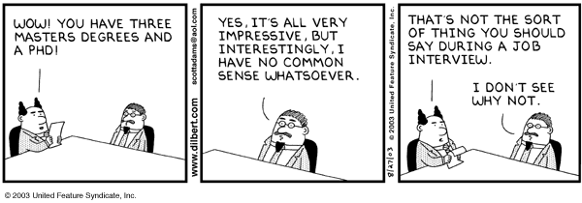
Tools and Tips for Speaking to the Press
Do your homework
Write down your main points and study in advance
Remember the 5 Ws
Keep your message simple
Avoid jargon

Slide 35
WRITING IN PLAIN LANGUAGE
INSTEAD OF… TRY THIS…
Abbreviations (NDAA, TSOs Spell it out!
Right to work Closed/Open shop
Representation Voice in the workplace
Raise the debt ceiling Pay our nation’s bills
Bargaining Unit Workers protected by a union contract
Arbitration/Grievance Defending your rights
The Union We, us, working people

Slide 36
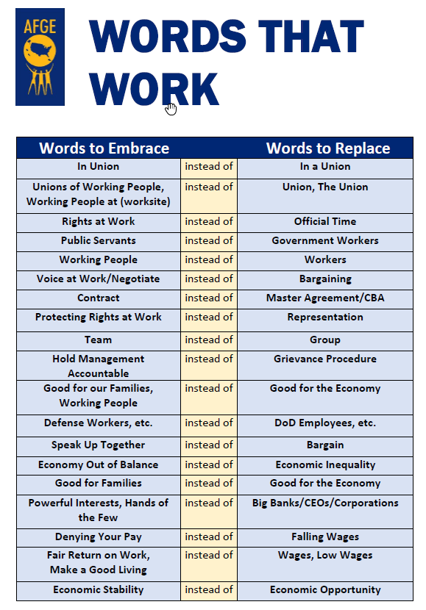
AFGE’s Words That Work
It’s important to use terms that elicit positive reactions from readers and editors.
By making sure you embrace these words, you will ensure you are keeping with the same messaging by AFGE as a whole

Slide 37
Nailing the Interview
Carefully review and practice talking points and common questions provided by staff before interview.
Know which 2-3 key points you definitely want to make going into the interview and say them out loud to yourself.
Press answers should always:
Be concise and to the point, avoid run-on answers
Repeat part of their question so it can be easily sound-byted
Always explain the “why,” not just the “what” and “how” of your response. For example, when talking about federal pay, don’t just talk about that fact that we’re calling for 5.3 due to FEPCA. Also talk about how recent pay/benefit cuts have forced millions of feds to delay buying a home, sending kids to college, and putting food on the table, and how 5.3 will at least make them even. Address the reporter by name during intro and outro

Slide 38
Nailing the Interview
Assume you are always on the record and always being recorded (video and audio)
Never say you’re speaking “off the record” – especially to large groups of reporters
Some exceptions can be made for long-trusted reporters, but these are very few
Avoid being overly-friendly with reporters in front of other reporters/official audiences:
They will write less-favorably about us to compensate for any perceived bias.
If asked about an unfamiliar subject or piece of legislation:
Say “I don’t have all the facts right now, but we’re reviewing it closely and I will have someone follow up with you,” then pivot back to your talking points on the issue you’re there to discuss.
When interviewing on camera:
Wear a solid colored shirt and tie
Push your glasses to the top of your nose so they do not block your eyes/reflect light into the camera
Assume the microphone is always on and recording for broadcast
Sit still with hands folder in front of you.

Slide 39
Nailing the Interview
WINNING STRATEGIES
Keep to your talking points
But be conversational
Don’t get flustered
Remember to smile – even if the interview is over the phone!
Reinforce the message
Get a question you don’t want to answer? Learn the art of “satisfy and steer”
If you don’t know what to say in a given moment, avoid “uhh” while thinking. Just pause, collect your thoughts, and continue.
If you’re having trouble finishing your thought, avoid saying:
“Those type things”
“Things of that nature”
Instead, say “my point is” then reiterate the central point of your response

Slide 40
The Good, The Bad, and The Ricky Bobby

Slide 41
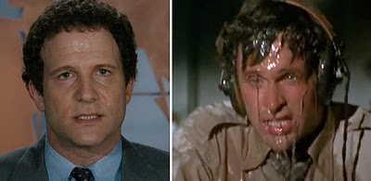
Being Interviewed on Camera
Break into groups of three
Each person will take a turn filming, interviewing, and being interviewed
Write down three questions to ask the other person
Try to remember the keys to your interview

Slide 42
Nailing the Interview
WINNING STRATEGIES
Keep to your talking points
But be conversational
Don’t get flustered
Remember to smile – even if the interview is over the phone!
Reinforce the message
Get a question you don’t want to answer? Learn the art of “satisfy and steer”
If you don’t know what to say in a given moment, avoid “uhh” while thinking. Just pause, collect your thoughts, and continue.
If you’re having trouble finishing your thought, avoid saying:
“Those type things”
“Things of that nature”
Instead, say “my point is” then reiterate the central point of your response

Slide 43
TRAINING MATERIALS ONLINE
WWW.AFGE.ORG
Writing newsletters
Telling stories
Conducting interviews
Building communications campaigns
Much, much more!

Slide 44
Multimedia and You

Slide 45
Multimedia Matters
In today’s content-hungry world, journalists and bloggers need to do more with less. Visuals help keep their readers engaged and including images and videos make it easy for media and influencers to write about and share your brand’s story.
Make your story stand out and build deeper connections with your audiences by promoting multimedia content – videos, photos, infographics and audio clips – proven to increase views by 1.4X with images and 2.8X with videos.*
* PR Newswire analysis of 2015 press releases.

Slide 46
How to Get Started
Most of us already have the tools we need to produce a successful video. In order to start filming and posting videos, all you will need is a smart phone with a functional camera and free hard drive space.
For more complex projects, you can always contact the AFGE Communications Department for advice.
Filming with no audio needed: The majority of users are watching video without sound. That means in order to engage viewers the video should either have captions added or the narrative of the video should not be driven by sound.

Slide 47
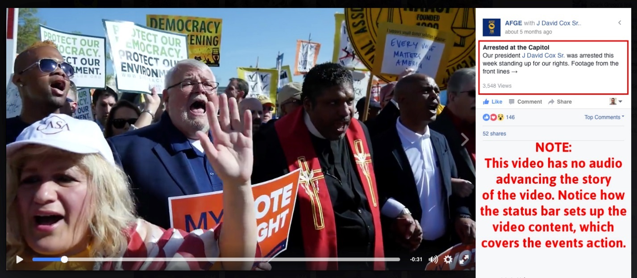
No Audio

Slide 48
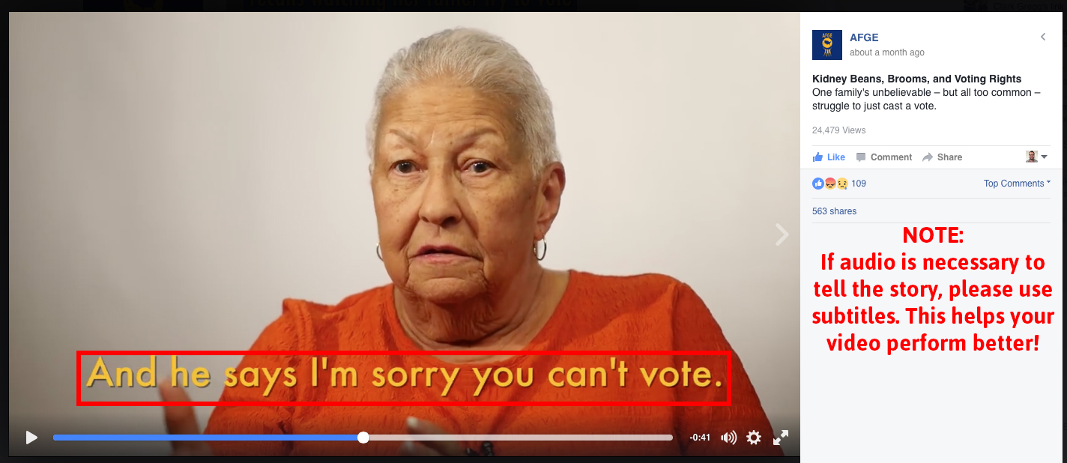
Audio

Slide 49
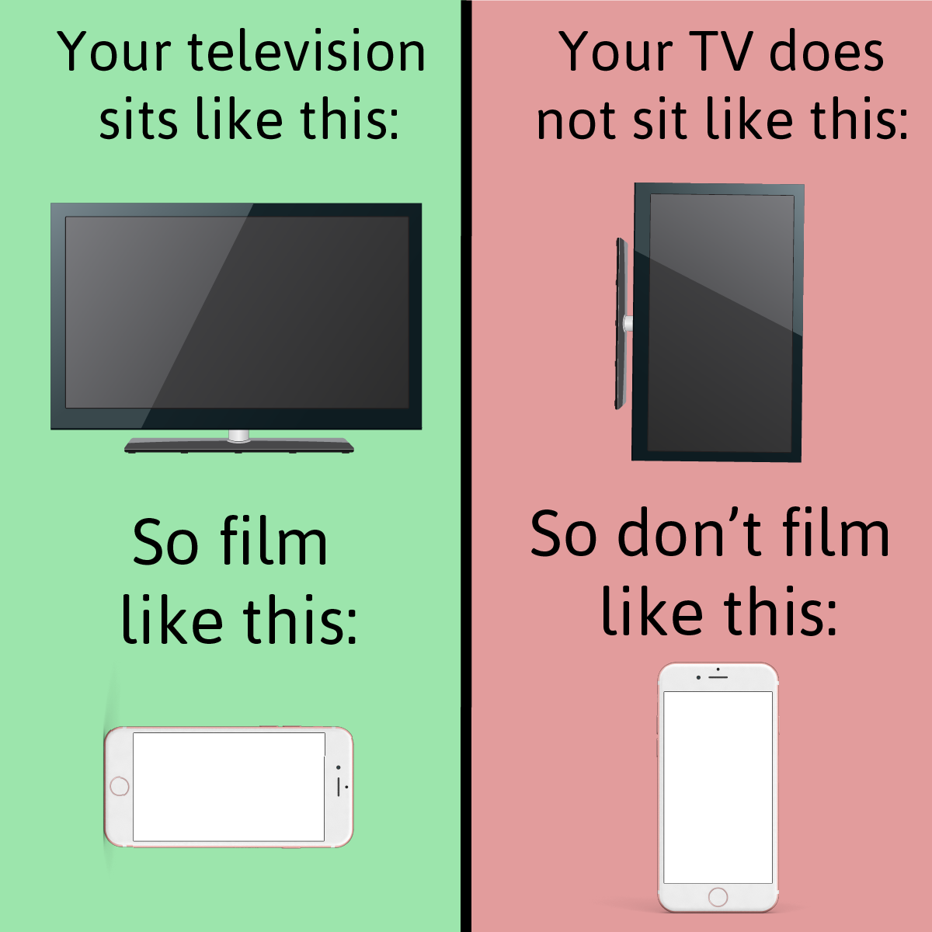
Positioning your Cell Phone While Filming
You can fit more onto the screen when filming in landscape. Portrait is for photographs. Landscape is for video.
You are losing a very large amount of space when filming in portrait and it is difficult to view on some screens.

Slide 50
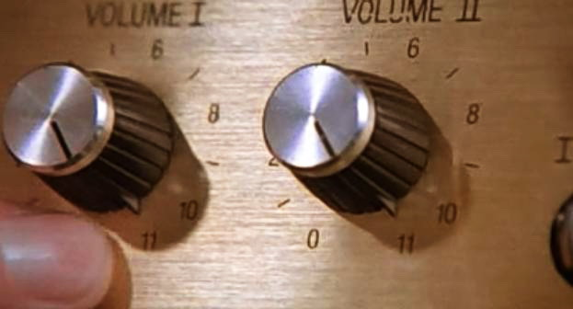
Recording Sound
Sound is often overlooked but very important part of a video. If you are recording video, you are also recording sound. So why not work for the best sound possible? Make sure that you are close to the subject/action that you are recording, that way you will have the best possible sound.
The further you (and your camera’s microphone) is from a subject the lower the quality of the audio is. Get in close!

Slide 51
Framing your Shot or The Rule of Thirds
Think of your shot as if you are filming on a grid, with nine separate squares inside of it. The eye is naturally driven to the intersection of these points.
Thus, when framing your shot you want to utilize those points in order to create a compelling image.
Divide your Image into a grid

Slide 52
Framing your Shot or The Rule of Thirds: Good

Slide 53
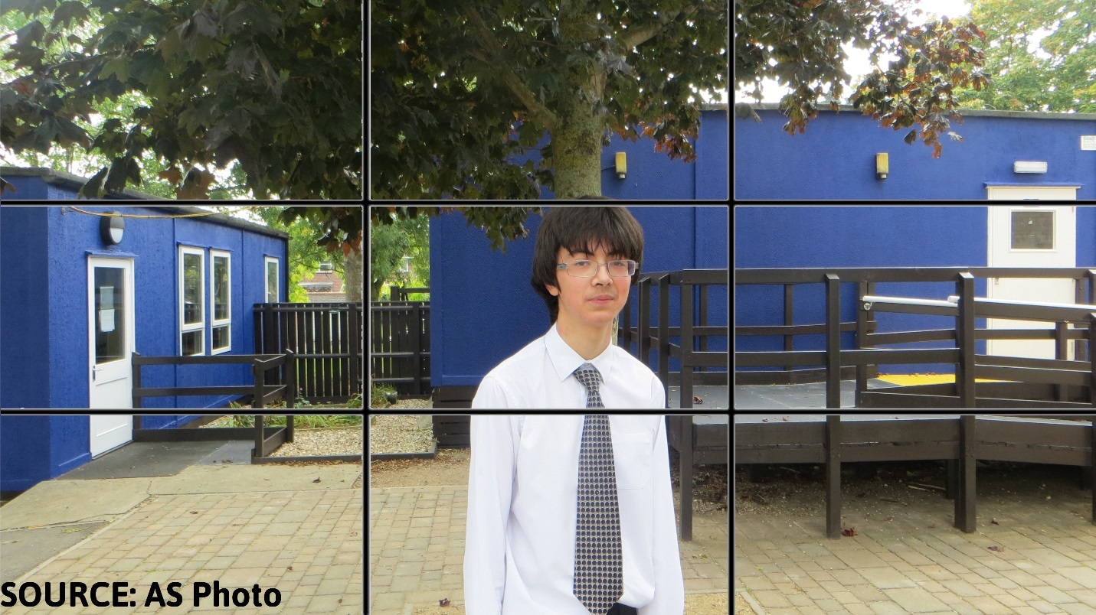
Framing your Shot or The Rule of Thirds: Bad

Slide 54
Best Practices
These best practices are a baseline in creating video content for your local.
Do not zoom in on a subject especially if you are filming hand held. If you want a closer shot… get closer. Zooming from a cell phone degrades the image quality.
Verify that your subject is in focus before recording.
Edit the beginning and the end of a video so that you’re only publishing the action, this can be done in a cell phone.
If possible, use a tripod. If you can’t, try to keep your phone as stable as possible.
Be short and to the point. Get your main message across as early in the video as possible.
Identify yourself in your union capacity: I.E. “Jane Doe, Steward at AFGE Local 999, who represents employees at Springfield VA Medical Center.”
Contact the AFGE Communications department for equipment recommendations or technical questions.

Slide 55
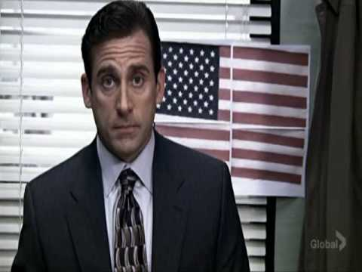
Practices to Avoid
Steer clearing of these filming pitfalls
Filming yourself in your government uniform
Identifying yourself in your capacity as a federal employee
Moving the camera away from the subject of the video
Filming in portrait
Filming inside U.S. Government facilities without the expressed written consent of an agency’s public affairs department

Slide 56
Sharing Your Multimedia
Now that you've completed your video the next important step is to share it with your audience. Here are some tips on getting the word out about the story you've captured.
Upload the video natively to Facebook and/or Twitter. Do not share a YouTube link on Facebook.
Ask your members, friends and family to share the video on their pages.
Send the video in your emails.
Include that a video has been released in your newsletter.
Report your performance to AFGE National!

Slide 57
Sharing Your Multimedia
Here are some suggested platforms for sharing your multimedia content with the world:

Slide 58
Who Cares About Social Media? CONGRESS.

Slide 59
Congressional offices are more inclined to use social media for their jobs than they were in the past—and they plan to use it more in the future.
Social media has improved relationships between constituents and Congress.
It’s the top news outlet for Capitol Hill insiders on the weekends.
Sources: The Congressional Management Foundation
National Journal
Notes:
The full results: http://www.congressfoundation.org/projects/communicating-with-congress/social-congress-2015

Slide 60
45% of Capitol Hill Insiders
say accessing social media is an important part of their daily work...
...and they expect to rely even more on social media in the next 1-2 years.

Slide 61
30 comments
on a social media post...
...are enough to get a Congressional office's attention, but they need to be posted quickly—and identified as being from a constituent—to be given value.

Slide 62
Digital Engagement Matters FOR THOSE AMERICANS WHO ARE WAITING FOR A REASON TO ACT.

Slide 63
48.9 % of Americans
know about the issues in their community...
...but there's a gap between their values and their actions.

Slide 64
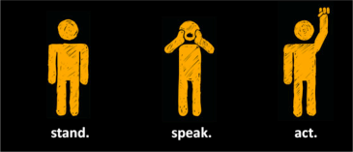
When they take action it’s because they have a sense of "credentials,“ often from:
a personal connection,
a professional tie or,
an emotionally meaningful experience.
Source: "Understanding America’s 'Interested Bystander':
A Complicated Relationship with Civic Duty " from Google
Notes:
The full results: http://googlepolitics.blogspot.com/2015/06/understanding-americas-interested.html?m=1

Slide 65
Example: Bike policy
a personal connection
Source: "Understanding America’s 'Interested Bystander':
A Complicated Relationship with Civic Duty " from Google
Notes:
The full results: http://googlepolitics.blogspot.com/2015/06/understanding-americas-interested.html?m=1

Slide 66
Example: Bike policy
a professional tie
Source: "Understanding America’s 'Interested Bystander':
A Complicated Relationship with Civic Duty " from Google
Notes:
The full results: http://googlepolitics.blogspot.com/2015/06/understanding-americas-interested.html?m=1

Slide 67
Example: Bike policy
an emotionally meaningful experience
Source: "Understanding America’s 'Interested Bystander':
A Complicated Relationship with Civic Duty " from Google
Notes:
The full results: http://googlepolitics.blogspot.com/2015/06/understanding-americas-interested.html?m=1

Slide 68
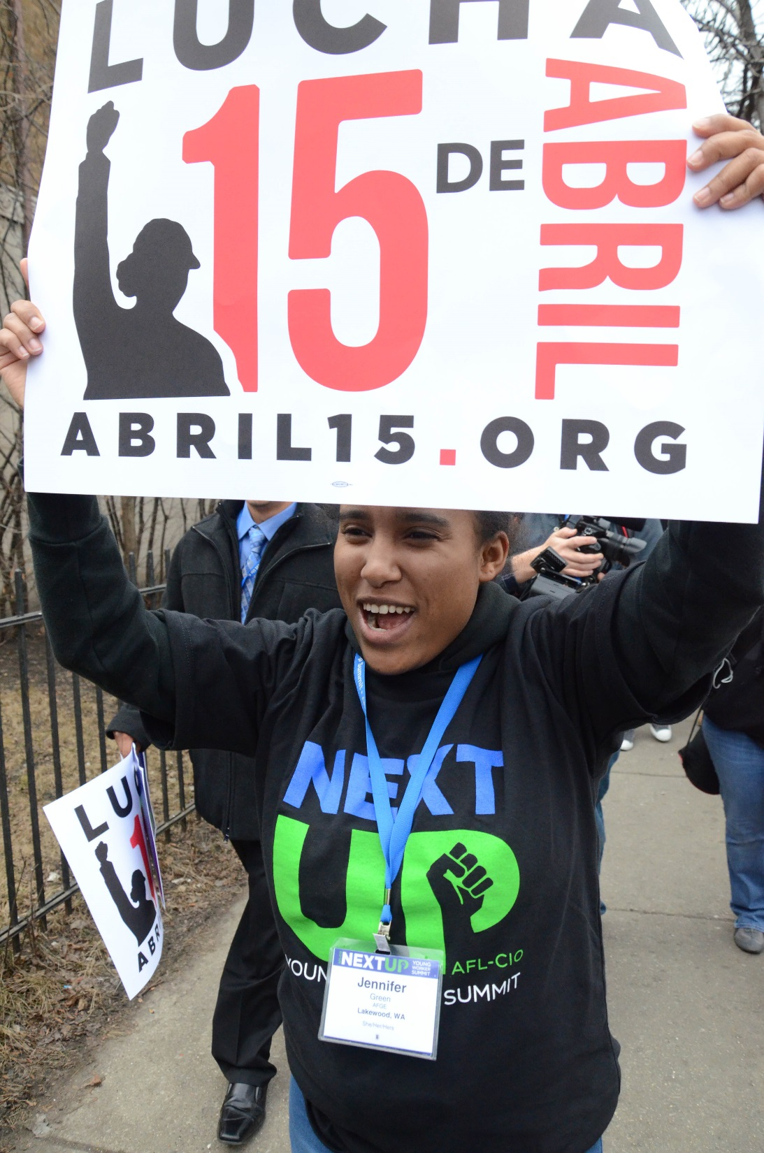
Social media can help provide those "credentials“ and help amplify action that they take.
Source: "Understanding America’s 'Interested Bystander':
A Complicated Relationship with Civic Duty " from Google
Notes:
The full results: http://googlepolitics.blogspot.com/2015/06/understanding-americas-interested.html?m=1

Slide 69
Digital Engagement In Action

Slide 70
Social Workers Join UNITE HERE in Boycott Battle
Social work academics, grassroots organizers and allies support marginalized hotel workers in their boycott of Hyatt Hotels in San Antonio, Texas
Goals:
Build community among various social work and allied communities
Raise awareness
SSWR relocate conference
SSWR change policies regarding conference planning to ensure similar issues don’t arise in the future

Slide 71
Role of Digital Advocacy in the Campaign
Garner signatures for petition (Change.org)
Raise awareness, plan and mobilize people (Facebook, Twitter)
Express concerns to SSWR leadership (email)

Slide 72
Results of the Campaign
Thousands of people engage in the advocacy effort in some form
SSWR eventually agreed to relocate almost all conference activities outside of the Hyatt Hotel
Forum held at conference for advocates to meet with Hyatt workers and UNITE HERE members
Articles written in Labor Notes and Social Work Helper
Petition signed by nearly 1,200 people – signers represented over 15 nations and 44 states
500 mentions of the Hyatt/Worker SSWR effort via various social media sites

Slide 73
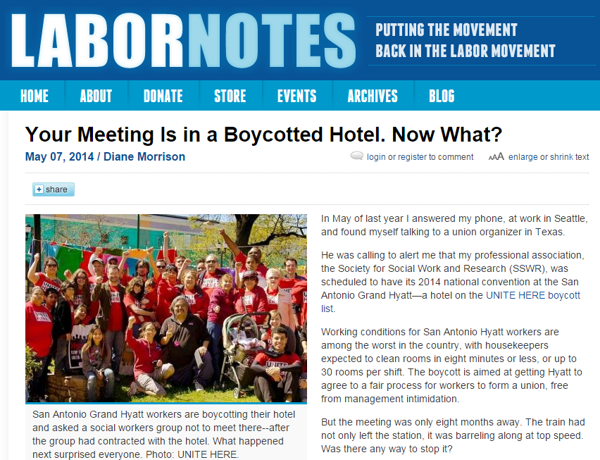
Lessons Learned from UNITE HERE’s SSWR Campaign
Lessons Learned
Consider how and where to incorporate social media
Social media is most beneficial when multiple forms are utilized within a campaign
Social media provides flexibility and helpful tools to organizing

Slide 74
Holding Press Conferences

Slide 75
You’ve Got News and You Want to Share it. How?
Individual outreach to reporters is good if you are seeking to add your commentary to the news, but what if you have a story that you want to put out for the general public and press to cover?
You have the following options:
Press Release
Press Conference
Telepress Conference
Social Media Post
Outreach to individual reporter

Slide 76
Best Practices for Press Releases
The AFGE Communications Department has the resources available to assist you in crafting and distributing press releases. With that said, when composing your press releases, here are a few things to consider.
Write compelling headlines in the active voice to grab readers right off the bat
Incorporate examples or statistics to show how issue affects workers and people in your communities
Highlight members’ stories where possible to bring local attention to national issue
Incorporate links into text to provide added content to readers
Incorporate photos into releases to tell the story visually
Used best for: Grievances, Statements, Post-Press Conference Release, News from You

Slide 77
Best Practices for Press Conferences
If you have big news and want to put it out in front of a local audience, press conferences are an option.
But, in doing so, there can be issues:
Finding space
A/V equipment – or lack thereof – will make coverage for media and general public difficult
No press shows
You get a question you aren’t prepared for
To promote a Press Conference, you should first put out a Media Advisory.

Slide 78
Best Practices for Press Conferences
Media Advisories should have the following:
What is happening?
When is it happening?
Who will be there?
Where will it be?
How can they contact you?
At AFGE Headquarters, we use an online program to create press lists, identify reporters, and send mass advisories to them for you.

Slide 79
Telepress Conference
If you have a large story you want to share, but don’t want to do a press conference (for logistical reasons or practical) telepress conferences are a good alternative.
You are able to reach a wider audience across the entire country.
It can be set-up and maintained by AFGE Headquarters
You can see who called in
You have an easier time answering hard questions
There are no fears of the public or press not showing

Slide 80
Social Media Post
If the news you want to put out isn’t noteworthy enough for local or national press, social media is a great free avenue to promote it
Using your Council’s Twitter or Facebook page you can:
Announce new hires
Comment quickly on something happening in the news or locally
Reach an audience across the country and world
Engage with reporters and decision makers
And receive increased promotion from AFGE National’s social media accounts through shared posts and retweets

Slide 81
Individual Outreach
If there is something you think the press should know about, but you don’t want it to come back on your Council, Local, or AFGE National, individual contact with a reporter is an option.
By contacting a reporter you have a pre-existing relationship with you can:
Go off the record and give the background information
Provide publicly available documentation
Be the first to get your story out without tarnishing anyone
You become a future source and insider for news about the topic

Slide 82
Connect!

Slide 83
Ways to Connect with AFGE Online
www.afge.org
Sign up for email alerts via AFGE website
www.facebook.com/afgeunion
www.twitter.com/afgenational
@afgeunion and @afgeyoungworkers
Join by texting AFGE to ‘225568’

Slide 84
Questions?

Slide 85
Cheston McGuire
Cheston.McGuire@AFGE.ORG
http://bit.ly/afgecommstraining

