Slide 1
I AM AFGE
New Employee Orientation
Notes:
Script
Welcome to the Union New Employee Orientation. The employees at this facility, including you, are a part of the Union here, are covered by the protections of our union contract, and together as a part of the same team. Our Union is all of us, and we stand side-by-side making improvements and having a say over the workplace. Most in our local choose to be members, pay dues and have voice over the terms and conditions of employment, but no matter what we each choose, we are a part of the local and covered by our strong Union contract. AFGE is your Union, and you are AFGE.

Slide 2
You are LOCAL XXX
Notes:
Script
When folks ask, you can tell them your Local is AFGE LOCAL ____. AFGE stands for American Federation of Government Employees. We cover 700,000 Federal and DC government employees.
Your local is one of many in AFGE- we are the main federal sector labor union- nearly every federal employee that is in a union is in AFGE. You have a chance to have a big voice not just at our location, in your Agency, but also in our Union at large. It is pretty exciting, honestly.
Your local covers [Units]], covers [number] employees, including you.

Slide 3
What does this mean for you?
Notes:
What does all this mean for you?
Well, you are a one of many AFGE employees in your Agency, and one of 700,000 Union members. So your voice carries in this workplace as a member of your Union. We have a say, as a Local and a Union, in our working conditions. Big stuff like shifts, leave, health and safety. Things like leave, break times, due process. We get a voice at the table as a Union and get an equal say with the Agency about what the terms of employment are when we negotiate our contract. That contract is the law of the land at the work- it’s the rules we and the agency follow.
Who decides what we negotiate in that contract- what we ask for and what we get?
The members!

Slide 4
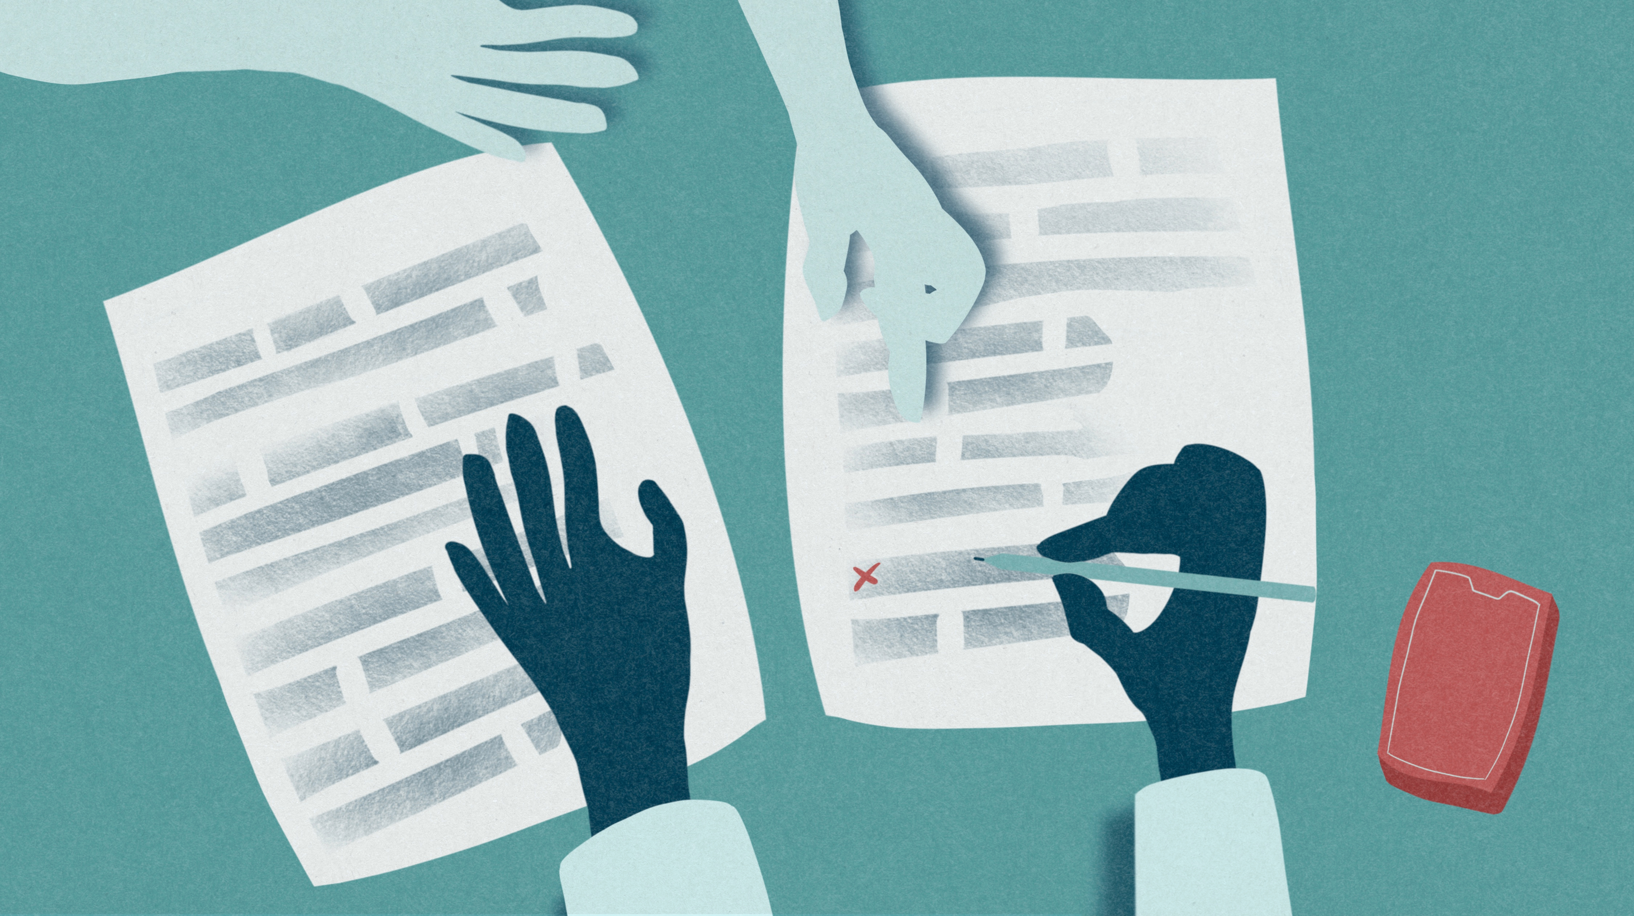
Notes:
What sort of stuff do we bargain for? You name it, we bargain for it. We have a contract now that covers lots of issues, and is the law of the land in our workplace. Those in the Local who are dues paying members get surveyed, and the issues they say matter to them determine what we go to the table and fight for together. The more of us there are as dues paying members, the more of a voice we have, the better we do when bargaining. That’s true- the Agency says it pays attention to how many people care enough to get involved, and the more that join and have a say, the better we do.
In fact, our Local is a part of a big victory in that regard.

Slide 5
Collective Bargaining Agreement (CBA)
Scheduling
Union Rights
Job Protection
Annual leave/sick leave/FMLA
Breaks
Comp time
Due Process
And many more contractual rights
Notes:
Your contract covers lots of topics and includes hundreds of rights on the job that you wouldn’t have if not for our bargaining. Every right in the contract is because members in your local decided they cared about and wanted to demand that right, and stood together to win it at the table. You have a voice in your local and should make sure your needs are heard, too. AFGE is your union, and you are AFGE!

Slide 6
5.2%
WORKING HARD WITH CONGRESS AND THE ADMINISTRATION, AND ENGAGING IN MEMBER DRIVEN LOBBYING, AFGE MEMBERS EARNED THE BIGGEST PAY RAISE IN OVER 40 YEARS
LOBBYING
CALLS TO CONGRESS
LETTER WRITING
Notes:
Your local also helped win a huge pay raise for you and your coworkers. The 5.2% pay raise for federal employees is in the President’s 2024 budget. Not only would this be the largest increase since 1980, it would also be a significant step in the right direction for efforts to recruit and retain the next generation of federal worker. Let there be no doubt how we got here- AFGE members stood shoulder-to-shoulder, lobbying for the increase. At their local representatives offices in their congressional districts, and on the hill. Calls to congress, and letter writing. Each and every call, letter and office visit by and on behalf of the 700,000 federal employees covered by AFGE made the difference.

Slide 7
OUR
WORK
MADE
THE
RAISE
HAPPEN
Notes:
Our union is our members, and we got our raise because thousands of us made our voice heard and demanded a fair pay increase. This is the result of our Union’s hard work- members calling the hill, writing letters, our members, leaders and staff lobbying and building relationships over years to lay the groundwork for this win. The more we grow, the more members we have, the more people that get involved, the better we do when we push for pay raises. Our Union is fighting for better pay and winning.
No other groups are. If you aren’t a member yet, it is time to invest in better pay and join and become active.
And think of this? Who fought to get pay raises for federal employees? What group is advocating, making calls, knocking on doors, rallying for better pay? Can you think of any other interest group? Any other organization? The answer is “no.” It is us and only us.
If you only remember idea from this meeting, let it be this: we, as a Union, are the only group fighting for better pay. Nobody else is fighting for us. Nobody else is looking out for our interests, its just us. And we are winning.

Slide 8
STAFFING THE FEDERAL SALARY COUNCIL, AFGE GOT A PAY RAISE FOR 32,900 FEDERAL EMPLOYEES JUST LAST YEAR. AFGE IS THE REASON THIS HAPPENED.
Notes:
AFGE holds two seats on the Federal Salary Council because we represent so many engaged and involved federal employees. On that Council, we proposed federal employees working in Fresno, Calif., Reno, Nev., Rochester, New York, and Spokane, Wash get a locality pay raise next year. We made the recommendation and pushed for the President to adopt it, and thanks to our activism and shared influence, he did. Now, the Office of Personnel Management is taking the final steps to implement the new General Schedule (GS) pay localities.
New counties will also be added to 43 existing localities, so those working and living in these counties will get a locality pay bump as well.
The changes mean about 32,900 federal workers will see a locality pay raise starting Jan. 1, 2024. Who did this? AFGE members did. Your local is AFGE- you are AFGE.

Slide 9
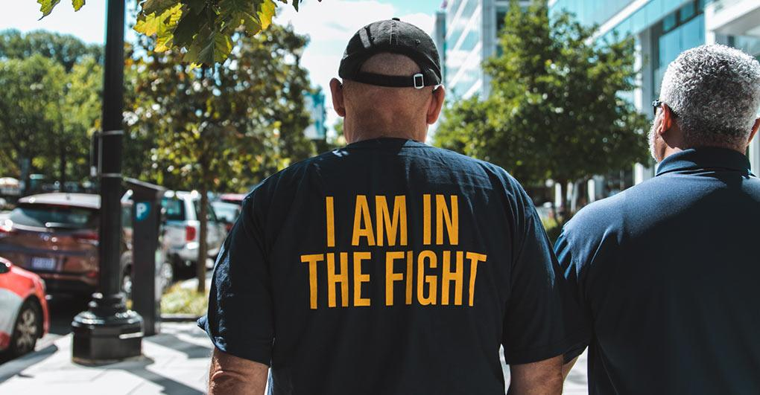
How did we do it? Together!
Your Union Makes the Difference
Notes:
This is the result of our Union’s hard work- members calling the hill, writing letters, our members laying the groundwork for this win. The more we grow, the more members we have, the more people that get involved, the better we do. We are working together and winning more.
no other groups are. If you aren’t a member yet, it is time to invest in better pay and join and become active.
And think of this? Who worked to get pay raises? What group is advocating, making calls, knocking on doors, rallying for better pay? Can you think of any other interest group? Any other organization? The answer is “no.” It is us and only us.
If you only remember idea from this meeting, let it be this: we, as a Union, are the only group working for better pay. Nobody else is looking out for us. Nobody else is looking out for our interests, its just us. And we are winning.
That’s our Local, that’s your union. And today, you can join and win more.

Slide 10
You Can Join Your Local As a Member Today
Notes:
We will be able to help you join, have a voice and bring more home for yourself and 700,00 Federal employees today.

Slide 11
As a Probationary Employee
You have the right to join your Local right away- today
You have the opportunity to have a voice on the job- today
You have rights under our union contract- today
You have representational rights under law and contract - today
Notes:
As a probationary employee, you can join your union today. You don’t need to wait to have a voice on the job. You can join today, and have a voice on your terms and conditions of employment. As we go to the table to bargain everything from shifts, uniforms, leave and more- your voice counts and needs to be heard. And you have protections on the job- not just protections under the law, but protections under contract. Our power is great, your power is great, and we need you.

Slide 12
We protect Each Other
Due Process
Representation in investigations
EEOC rights for members
Workers Compensation for members
Notes:
This is a new job, and it is a good job. We have a say in what the job is, and are always working to improve it. But in the event we need to protect each other from discipline or other adverse actions, we do it well. You owe it to yourself and your family to join your coworkers and have all the protection you can get if you need it. Think about every boss you’ve had- some supervisors are fair, deliberate and reasonable. Unfortunately, some are not. In the event any of us find ourselves in trouble, we deserve the best representation- representation in any way we might need, and being a Union member guarantees representation in more matters. And we all support each other, not just by having skilled advocates and representatives to assist, but by paying for the services we need.
You wouldn’t go without health insurance. You wouldn’t drive without car insurance. Having a job without joining the union is the same. We need the representation of our union brothers and sisters, and the lawyers and representatives who work for us. We need a voice, and we need to have each others backs.

Slide 13
Our Local
AFGE Local [xxxx] represents employees of [agency] at [area/facility]
Dues: $[00.00] per pay period
Contacts for Local [0000]
Phone:
Email:
[Anything else]:
Notes:
Local XX at [facility] has dues of XXX. With that comes a voice on the job for the strongest Union there is, winning more rights and the biggest pay increase in Federal history. Your local contacts are [XXX], and the ones to reach out to learn how to get involved, and for any representational help you might want.

Slide 14
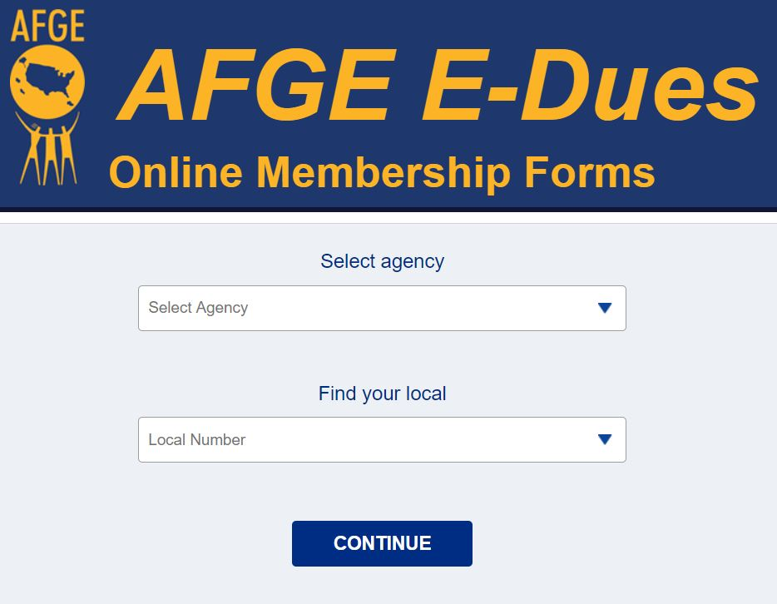
AFGE E-Dues
Local [xxxx] signs up all of its new members via AFGE E-Dues
Link: http://join.afge.org/L[xxxx]
Biweekly payment via bank draft or credit/debit card
Notes:
We can sign up in one of two ways- either online, where the dues come from your credit card or bank account, just like a gym membership.

Slide 15
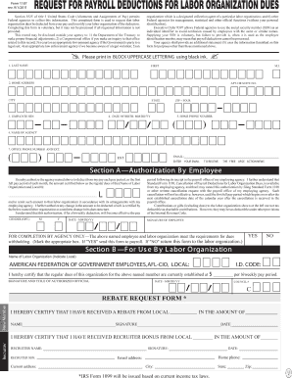
Standard Form 1187
Local [xxxx] asks that new members sign up by completing a Standard Form 1187
Authorizes payroll deduction of dues every two weeks
Submit completed form to webhelp@afge.org
Notes:
The other way to sign up is to fill out a form called an 1187. With an 1187 your dues get remitted from your paycheck. Both ways are pretty easy and make joining to have a seat at the table snap.

Slide 16
Contact Your Local Officers
[xxxxxx xxxxxxx]
President
[xxxxx xxxxxx]
Secretary-Treasurer
Phone:
Email:
Phone:
Email:
[xxxxxx xxxxxxx]
Chief Steward
[xxxxxx xxxxxxx]
Steward
Phone:
Email:
Phone:
Email:
Notes:
Let me take any questions you might have. If you have any questions I can’t answer, I will write them down and get you an answer.
[Take questions. If you need to time to obtain answer, please tell them you will get back to them]
Your Union means having a voice on the job, and its as easy as signing up today.
As you sign up, let me tell you a bit more about your Union. The above folks are your local officers. We are here to support you and your coworkers, and make sure you know what is happening and have a chance to weigh in. As time goes by, we hope you decide to get involved and take ownership of your local, making sure the work we do is the work you want done!

Slide 17
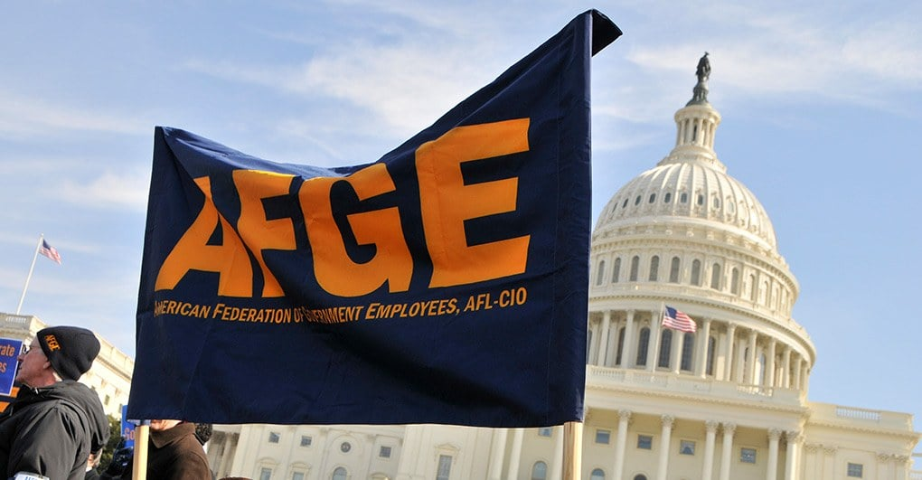
About AFGE’s Structure
Your local is a part of a nationwide Union.
Our National Union has three officers:
President, Secretary-Treasurer, NVP for Women and Fair Practices
Our union is divided up into 12 Districts by geography, our District is District XXX. Our NVP is XXX.
Together, these 15 make up our governing body, the National Executive Council.
Notes:
Your local is a part of a nationwide Union. The 700,000 members are all represented by our National Union has three officers. They are our National President, Everette Kelley, National Secretary-Treasurer, Eric Bunn, and National Vice President for for Women and Fair Practices, Jeremy Lannan.
Our union is divided up into 12 Districts by geography, our District is District XXX. Our NVP is XXX. The 12 District National Vice Presidents and the three National officers make up our governing body, the National Executive Council. Along with votes from the membership at our conventions, that is where national policy for our union comes from.
Why does this matter? Because, as a member, every one of these elected officers works for you. If you join, you not only have a say in how your workplace is run, but your union.

Slide 18
Working together, our union delivers wins
HUGE PAY RAISE
STRONG CONTRACTS
DUE PROCESS
A VOICE ON THE
JOB
Notes:
Our union, our local, every employee who is member of this Union has made big wins. We mentioned before the huge pay raise we won. We mentioned the strong contract we are going to be negotiating. As a member, you can have a say in what goes in there. We are going to have stronger protections on the job. And most importantly, your local means you have a voice on the job. AFGE is your Union, you are AFGE.

Slide 19
Welcome aboard!
Notes:
So, welcome to your Local. At this job, you have a Union- join today and have a voice, have security and have power. AFGE is your union- you are AFGE.

