Slide 1
AFGE Local XXXX Building Power
FOR MORE INFORMATION CONTACT: XXXX@GMAIL.COM

Slide 2
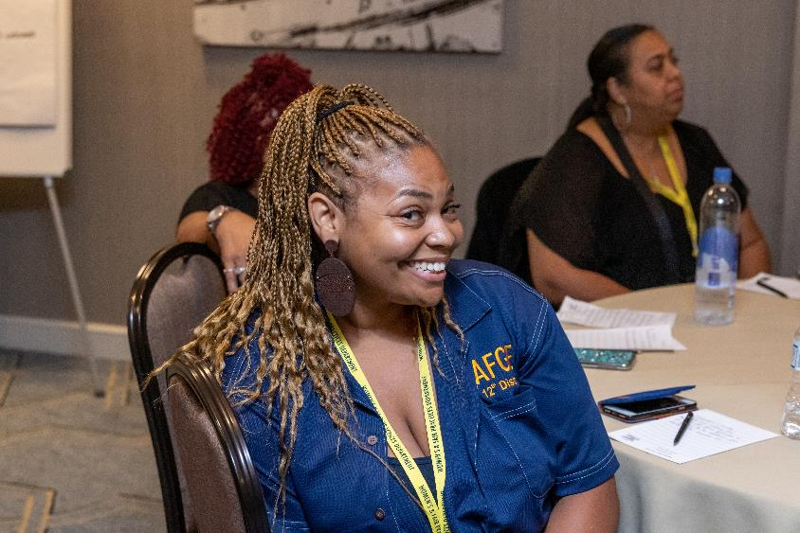
Welcome!
We are AFGE Local XXXX
This is YOUR union.
Contact XXXX with any questions.

Slide 3
Stay Connected
Get email and text updates sent to your phone.
Visit afge.org/GetConnected to sign up for email & text alerts!
Notes:
You can stay connected with your union, AFGE, by getting email and text alerts! There are a lot of changes happening quickly, and you need to be kept up-to-date and involved. Please visit the link I’ve dropped in the chat, afge.org/GetConnected and click “I would like to sign up for email and text alerts”

Slide 4
What is a Union
Being a Union member means having a say about what happens on the job
Notes:
Let’s speak plainly about what a Union is. A union is a group of employees who work together to determine the terms and conditions of employment with their boss. What does that mean? Well, basically, when you have a Union, the boss can’t change things about work without negotiating, until both sides agree. And that means pretty much everything, particularly with some new rules from the Biden administration. How small a change? Well, there are some famous cases saying even changes in prices to the vending machines must be bargained. But, really, we focus on what matters. Staying safe, being fair, getting what we need to make sure the job gets done right.

Slide 5
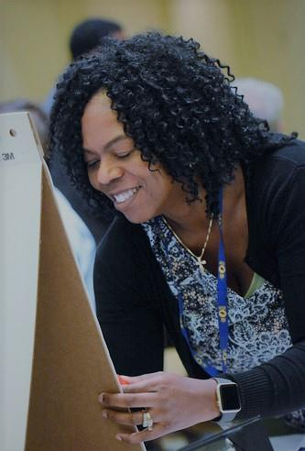
A VOICE AT WORK
Who knows your job better than you?
Who knows the needs of the job better than you?
Choose to be a member, choose to have a say.
Notes:
And if you are a union member, you have a say in what happens in those negotiations. You can help decide what needs to change, what needs to be fixed, what rights you and protections you need on the job. These are things that you, as a frontline employee doing the work of the agency, know better than anybody else. Being in the union, being active in the union, is having a voice in the work you do, your workplace, and how the work gets done. Choosing not to be a member means choosing not to have a voice at work.

Slide 6
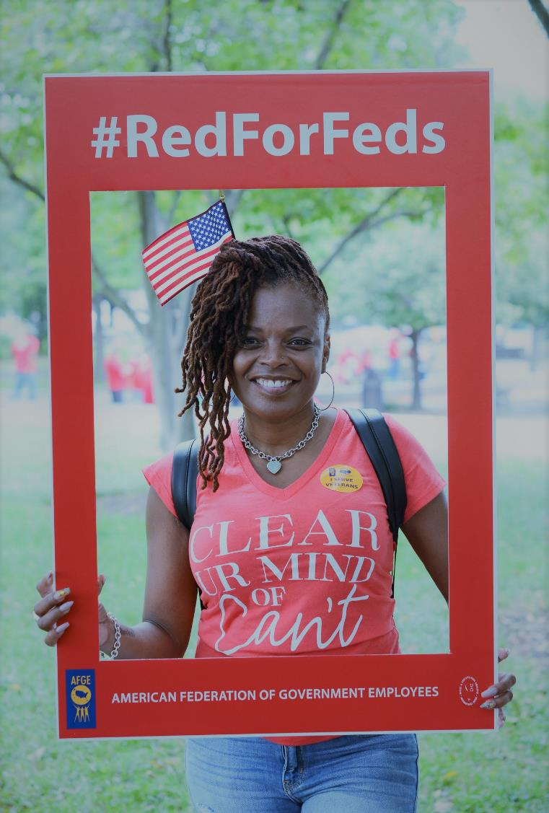
Your Union, Your Voice
Members decide because members are the union
Notes:
Members have a say in bargaining survey, members drive the issues the Union addresses. Members decide what changes the Union takes on, because members are the Union. Being a member means choosing to be involved and deciding the fate not just of your job but your workplace.

Slide 7
Raise your voice
Notes:
Being active in your Union comes down to deciding what you want to see change at your workplace. What do you care about? Let’s all take a moment to talk about it. If you aren’t a member yet, raise your hand, type in the chat, unmute yourself and have a voice. This Union is your Union – what issues should your Union be taking on?
[Take Issues, talk about how being involved in the union is the way to address the issues mentioned. Parking, hours

Slide 8
Have a voice on the job, build your union.
Join AFGE
Your Union Makes the Difference
Notes:
Ask yourself, do you want a voice on the job? If the answer is yes, raise your hand. Either raise your hand on the screen or press the raised hand icon.
Keep them up. Your colleagues are sending direct messages to you with membership forms. Joining today is the only way to have a voice at work. It is the only way to address the issues you care about and build your Union.
If you only remember idea from this meeting, let it be this: we, as a Union, are the only group fighting for the issues we care about. Nobody else is fighting for us. Nobody else is looking out for our interests, its just us.

Slide 9
QUESTIONS?
Join AFGE
Your Union Makes the Difference
Notes:
So, we need to sign up now. We need to join and build for power.
[While volunteers help people sign up, answer questions- use breakout rooms]
We should note that using just one or two of the AFGE member can cover the cost of your annual dues. Remember- the awesome member benefits add value and carry the cost of dues through savings and benefit programs.
Let me take any questions you might have. If you have any questions I can’t answer, I will write them down and get you an answer. I would like everyone to write their email in the chat, and I will get these answers to you.
[Take questions. If you need to time to obtain answer, please tell them you will get back to them]

Slide 10
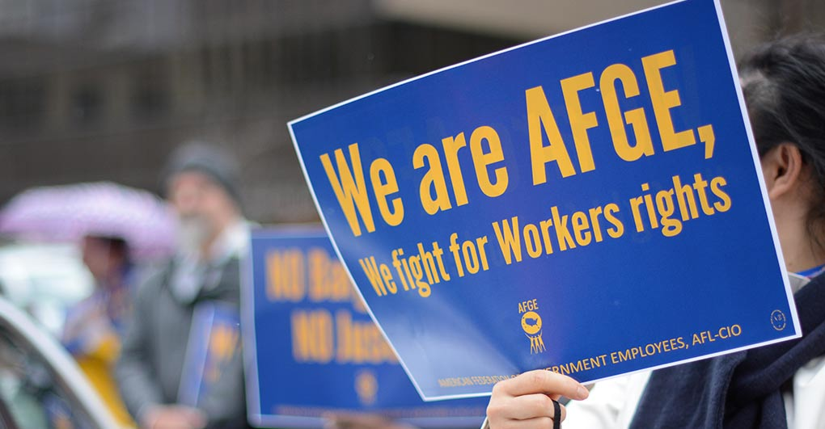
Join AFGE
Your Union Makes the Difference
Notes:
We will have more updates on ways to get involved and to improve our lives at work. Again, we want to keep you constantly informed. Please be sure you are signed up for updates through AFGE Action Network and AFGE Text, and that you gave your current home email and cell phone number on the sign-in sheet. This is a good start, brothers and sisters! Give yourselves a hand for all of you who joined us today and for taking the first step in improving our jobs!

