Slide 1
AFGE Local XXXX PPE and COVID-19 Update
FOR MORE INFORMATION CONTACT: XXXX@GMAIL.COM

Slide 2
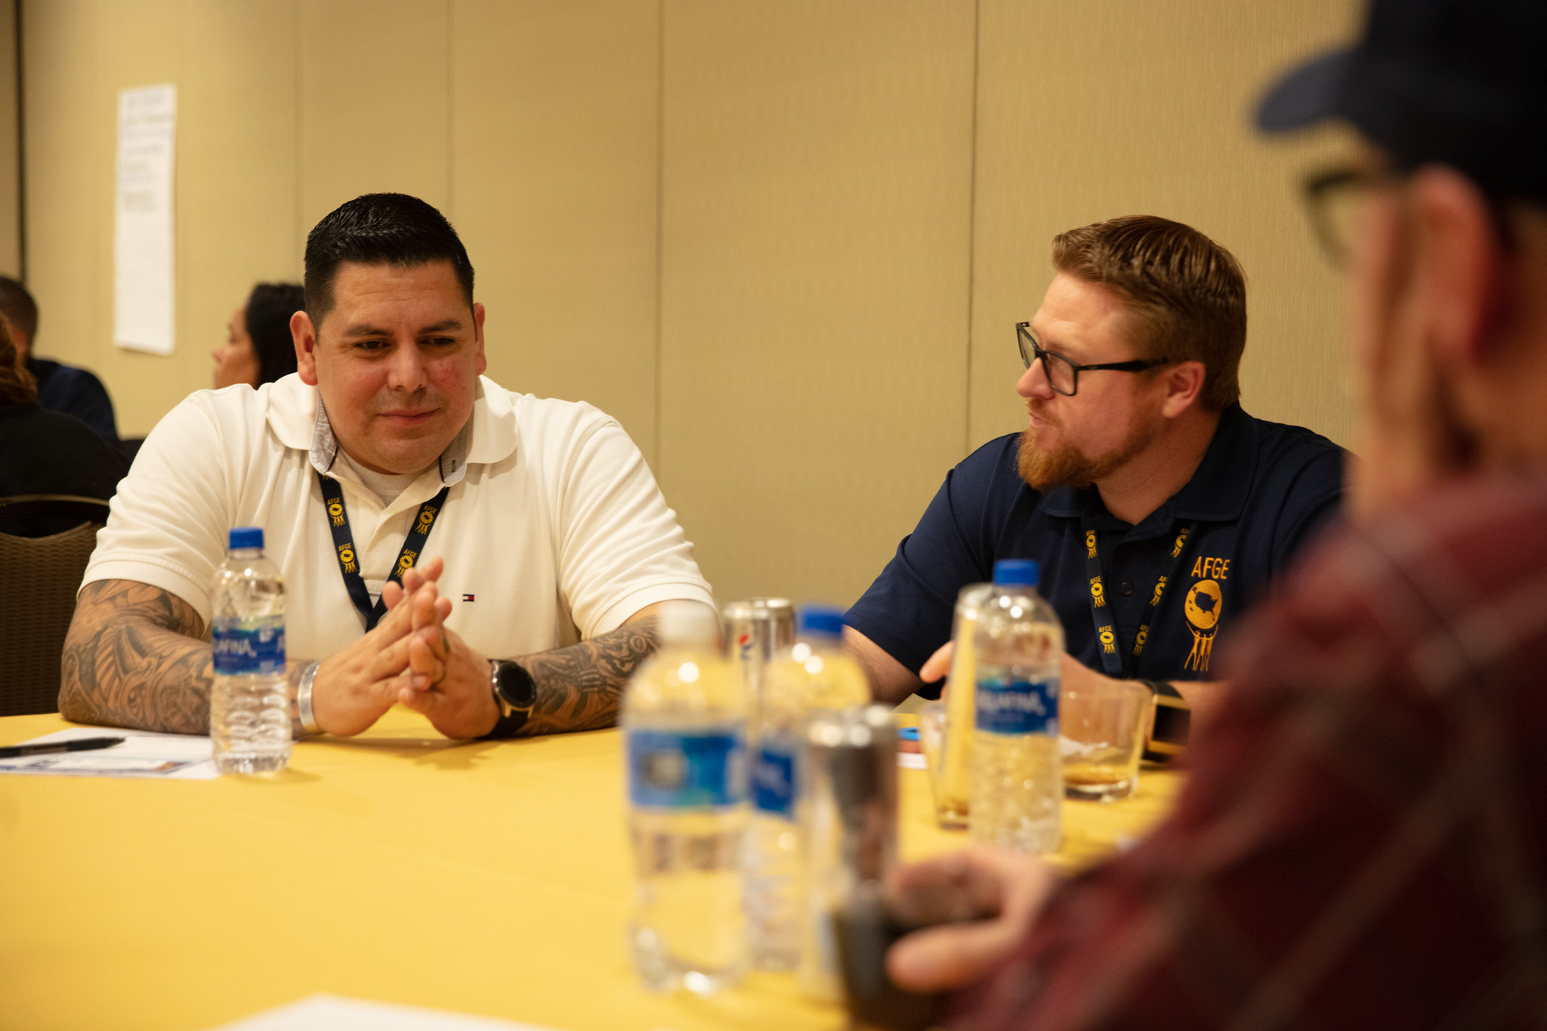
Welcome!
We are AFGE Local XXXX
This is YOUR union.
Contact XXXX with any questions.

Slide 3
Stay Connected
Get email and text updates sent to your phone.
Visit afge.org/GetConnected to sign up for email & text alerts!
Notes:
You can stay connected with your union, AFGE, by getting email and text alerts! There are a lot of changes happening quickly, and you need to be kept up-to-date and involved. Please visit the link I’ve dropped in the chat, afge.org/GetConnected and click “I would like to sign up for email and text alerts”

Slide 4
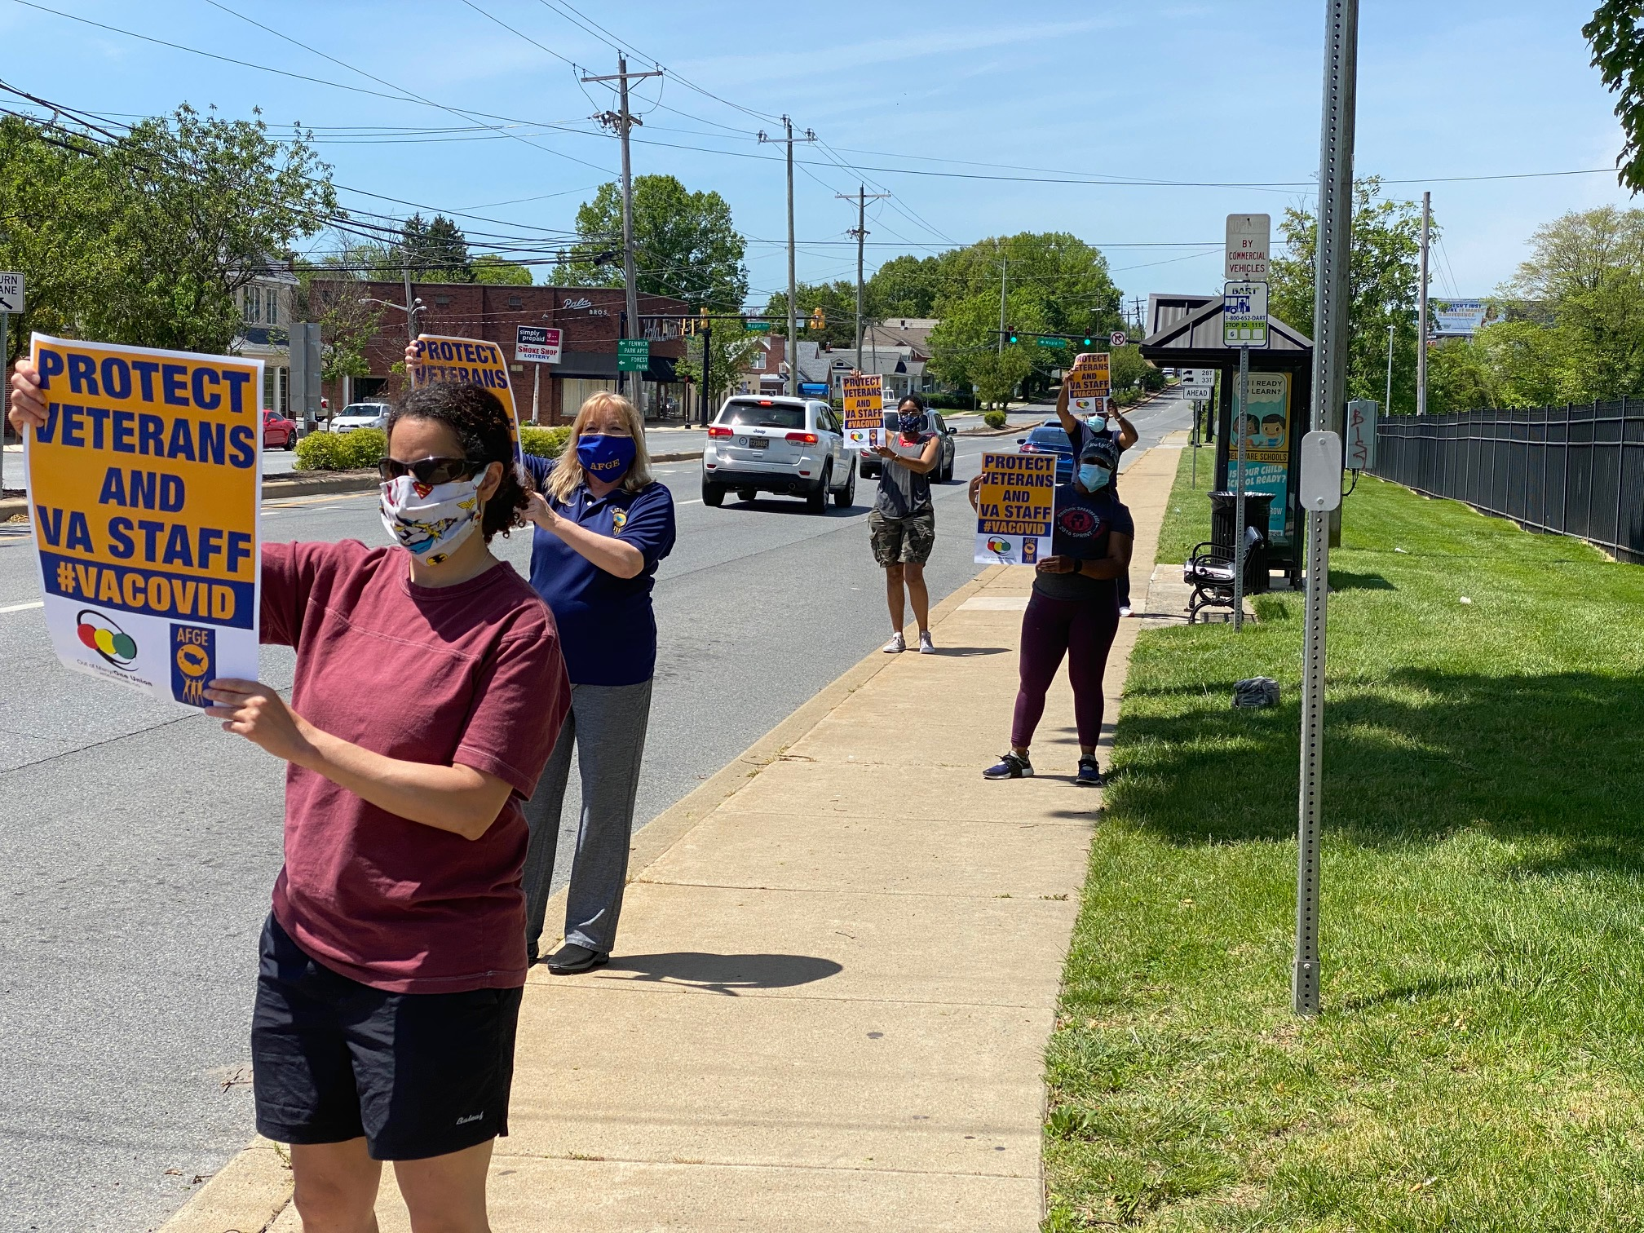
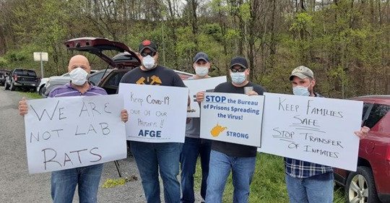
PPE ON THE JOB
Notes:
We are here to talk about PPE. For over a year now, AFGE has been leading the push for sufficient PPE on the job. Grievances, lawsuits, rallies and protests, lobbying, press conferences, inspector general investigations, OSHA investigations, the list goes on. AFGE has been leading the charge, often-times alone, to keep employees safe.

Slide 5
AGENCIES NEEDED THE PUSH
Agencies were totally unresponsive to employee concerns before our union placed stories in dozens of national, regional, and local news outlets.
CNN, MSNBC, New York Times, Wall Street Journal, Washington Post, Newsweek all covered the stories of AFGE members demanding proper PPE.
Pressure brought by AFGE members forced agencies to admit the issue, then take steps to resolve it.
Notes:
The fact of the matter is that most agencies we have worked with couldn’t be relied upon to provide the PPE we need on their own. The former VA Secretary to Wall Street Journal that the Department was intentionally misleading staff and the public regarding safety violations and PPE shortages during the current pandemic. We’ve had similar fights across the government this past year. But things have taken a turn, and we have new protections and resources to rely upon.

Slide 6
Providing PPE, Requiring Masks
Notes:
On January 20, 2021, we got a hard fought and well-earned Executive Order - EO13991, “Protecting the Federal Workforce and Requiring Mask-Wearing.” The EO states that we PPE will be provided, and that everybody in the federal workplace must wear a mask. OMB, acting on the EO has established that employees should continue to be allowed to work remotely when possible, requiring the use of masks or facial coverings by employees, contractors and visitors and limiting office capacity to 25%, unless it’s “physically impossible” or “poses a threat to national security.”

Slide 7
Online Health & Safety Resources for members at afge.org
Your Union Makes the Difference
Notes:
We have online resources to make sure that your local is getting the most out of the guarantee for sufficient PPE. We have PPE Safety information, including an online training to review the needs of the employees and workplace, resources for health and safety essentials, guidance on standing up a Joint Occupational Health and Safety Committees, bargaining guidance for building new workplace rights for workplace safety, and support for identifying coping strategies during a pandemic.

Slide 8
LEARNING WHAT WE NEED
Notes:
Take the class, learn what PPE you and your facility need, what you are entitled to, and how to get it. No matter where you work, what work you do, or whether your workplace is currently remote, you and your coworkers all need to be informed, empowered and aware of the PPE and safety precautions your workplace should have in place. This past year has demonstrated that we need an informed and empowered workforce to make sure every workplace is doing what it needs to keep us safe.

Slide 9
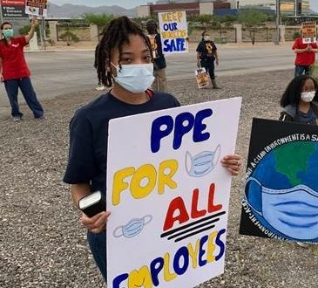
Make Your Workplace Better: Safer Workplaces.
Your Union Makes the Difference
Notes:
We are doing the work of keeping workplaces safe, on the local level and on the national level. Mobilizing, building power, and lobbying for additional protections.

Slide 10
AFGE wins in the COVID relief bill include:
15 weeks of emergency paid leave
Automatic assumption of workplace illness
Funding to protect feds against COVID
Your Union Makes the Difference
Notes:
This is the result of our Union’s hard work- members calling the Hill, writing letters, our members, leaders and staff lobbying and building relationships over years to lay the groundwork for this win. 15 weeks paid leave-The bill gives federal employees 15 weeks of emergency paid leave through September to address issues related to the coronavirus, such as exposure to COVID-19, a negative reaction to the vaccine, or caring for school-age kids and family members who are affected by the pandemic.
This additional leave will give federal employees more time to safely recover from COVID-19 or respond to related family care issues without being forced to take unpaid leave or return to work before it’s safe to do so.
Automatic assumption of workplace illness-This change will allow employees or their survivors to receive workers’ compensation benefits under the Federal Employee Compensation Act (FECA) without facing denials or lengthy appeals.
Funding to protect feds against COVID-The bill also provides $200 million for pandemic-related worker protection activities at the Labor Department, $100 million of which would go to the Occupational Safety and Health Administration (OSHA) to support OSHA enforcement and worker training in high-risk sectors, such as meat processing, health care, correctional facilities and agriculture

Slide 11
To keep your workplace safe, build your union.
Join AFGE
Your Union Makes the Difference
Notes:
Ask yourself, do you want to add your voice to 300,000 workers fighting to protect the workplace? If the answer is yes, raise your hand. Either raise your hand on the screen or press the raised hand icon.
Keep them up. Your colleagues are sending direct messages to you with membership forms. Joining today is the only way to have a voice at work. It is the only way to fight for better pay and benefits, and rights on the job.
If you only remember idea from this meeting, let it be this: we, as a Union, are the only group fighting for better pay and benefits for federal employees. Nobody else is fighting for us. Nobody else is looking out for our interests, its just us.

Slide 12
QUESTIONS?
Join AFGE
Your Union Makes the Difference
Notes:
So, we need to sign up now. We need to join and build for power.
[While volunteers help people sign up, answer questions- use breakout rooms]
We should note that using just one or two of the AFGE member can cover the cost of your annual dues. Remember- the awesome member benefits add value and carry the cost of dues through savings and benefit programs.
Let me take any questions you might have. If you have any questions I can’t answer, I will write them down and get you an answer. I would like everyone to write their email in the chat, and I will get these answers to you.
[Take questions. If you need to time to obtain answer, please tell them you will get back to them]

Slide 13
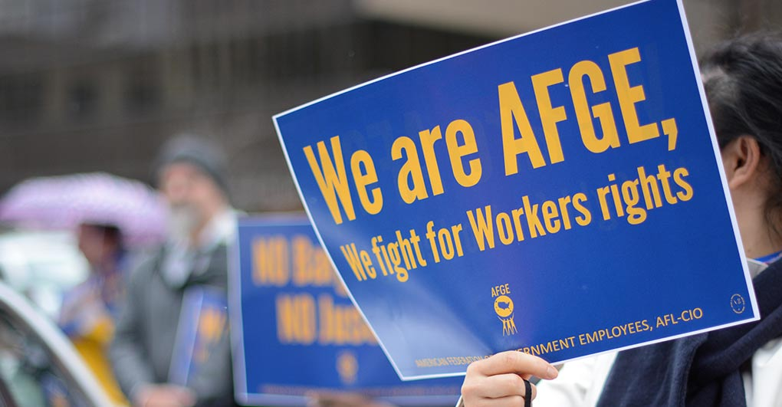
Join AFGE
Your Union Makes the Difference
Notes:
We will have more updates on keeping the workplace safe, and to improve our lives at work. Again, we want to keep you constantly informed. Please be sure you are signed up for updates through AFGE Action Network and AFGE Text, and that you gave your current home email and cell phone number on the sign-in sheet. This is a good start, brothers and sisters! Give yourselves a hand for all of you who joined us today and for taking the first step in improving our jobs!

