Slide 1
AFGE Local XXXX Pay and Benefits Update
FOR MORE INFORMATION CONTACT: XXXX@GMAIL.COM

Slide 2
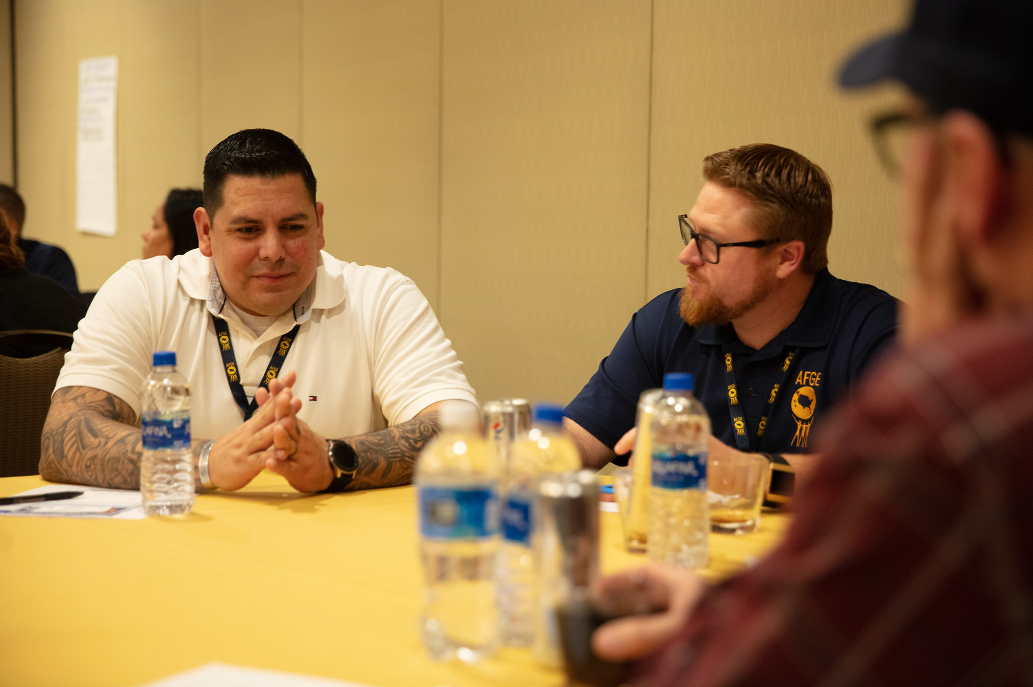
Welcome!
We are AFGE Local XXXX
This is YOUR union.
Contact XXXX with any questions.

Slide 3
Stay Connected
Get email and text updates sent to your phone.
Visit afge.org/GetConnected to sign up for email & text alerts!
Notes:
You can stay connected with your union, AFGE, by getting email and text alerts! There are a lot of changes happening quickly, and you need to be kept up-to-date and involved. Please visit the link I’ve dropped in the chat, afge.org/GetConnected and click “I would like to sign up for email and text alerts”

Slide 4
Pay, Benefits, and Rights on the Job
Notes:
We are here to talk about a new executive order that impact the Federal workforce. As you may know, we are coming out of years of attacks on the rights of federal employees and the federal workforce.
Attacks on due process, rights to representation, our pay, benefits and retirement have all been under attack. This meeting is an emergency meeting to talk about new changes regarding pay, our jobs and the rights we have at work.

Slide 5
Our union is winning pay increases for you – and fighting for 3.2% this year.
Notes:
We have pushed for years to increase federal pay, during the austerity of sequestration, and the turbulent past few years. We had a huge victory in 2020, were AFGE members and staff worked the Hill and secured a 2.6 percent pay increase. For 2021, OMB said they wanted no increase, saying ““In the context of budgetary constraints and recent, pandemic-related impacts on non-federal labor markets, the administration supports the policy in the bill to maintain for 2021 the current level of federal civilian pay.” Even still, we fought hard and got an increase for 2021. And we are pushing hard for our biggest increase yet for 2022. We have a 2.2% increase plus an additional 1% increase being championed on the floor, and with a more supportive congress, hope to see those wins.

Slide 6
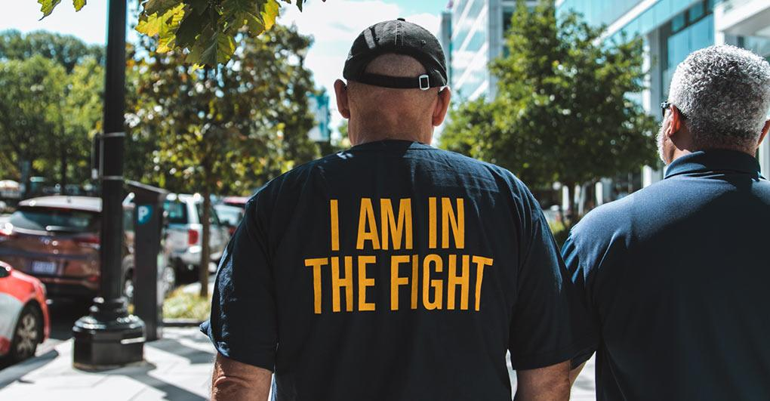
What’s the difference between a 1% raise and a 3.2% raise?
Your Union Makes the Difference
Notes:
This is the result of our Union’s hard work- members calling the hill, writing letters, our members, leaders and staff lobbying and building relationships over years to lay the groundwork for this win. The more we grow, the more members we have, the more people that get involved, the better we do when we push for pay raises. Our Union is fighting for better pay for federal employees- no other groups are. If you aren’t a member yet, it is time to invest in better pay and join and become active.

Slide 7
12 weeks of paid parental leave recently won.
Your Union Makes the Difference
Notes:
This pandemic has truly laid bare the lack of sufficient family leave for federal employees. That is why AFGE has been championing a new bill to provide paid family leave. Again, our Union has been at the forefront of this issue, and the hard work of activists, leaders and our union’s lobbyists has produced a bill that will provide 12 weeks of paid federal leave for employees who need it to care for themselves, a loved one, or if a family member is departing for or returning from military leave. This would be a huge win, FMLA provides for unpaid leave, which is an arrangement few can afford to make. We make these wins because we are a big union- the greater our numbers the more our calls get answered.

Slide 8
AFGE POWER
AFGE’s Legislative Director Named “Top Lobbyist”
AFGE’s Policy Director Named “Most Influential”
Notes:
We make these gains because our members are involved- the more calls, letters and visits to representatives, the better we do. We make successful pushes because we have revenue from dues to hire lobbyists to fight for us. A few short months ago, our legislative Director, Althea Predeoux, was named one of the country’s Top Lobbyists by The Hill, a very high honor for our Union and the work we do. Just a few short weeks ago, our Policy Director, Jacque Simon, was named one of the 250 most influential people in Washington. Their power and influence comes from us, growing and being engaged.

Slide 9
AFGE SERVES ON THE FEDERAL SALARY COUNCIL.
Your Union Makes the Difference
Notes:
AFGE’s Policy Director, Jacque Simon, currently serves as an employee representative on the Federal Salary Council, which serves to correct pay disparity between the private and federal sectors and makes recommendations locality pay. That power and influence is making a difference for better pay. Our membership power has impact- and growing our membership will increase that impact.

Slide 10
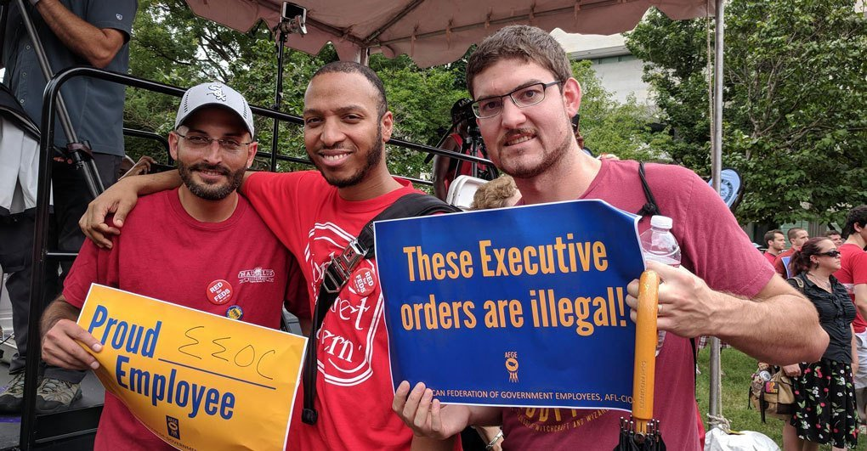
Building Back Better: Due Process, Fair Contracts, Representation.
Your Union Makes the Difference
Notes:
As you may know, the previous administration took a number of actions to attack federal employees with Executive Orders. We had our right to due process, robust contracts, have union representation on the job attacked. We even faced a proposal for a new class of employees- Schedule F employees- who would have no due process at all and were subject to a spoil system, subject to termination based upon loyalty to the president and not an individual’s merit or ability to do the job. AFGE has pushed hard and had all the previous executive orders rescinded. We are just now beginning the work of restoring the rights that were stripped, bargaining new contracts and building back stronger than we were before.

Slide 11
To win better pay and benefits, build your union.
Join AFGE
Your Union Makes the Difference
Notes:
Ask yourself, do you want to add your voice to 300,000 workers fighting to protect and improve our jobs? If the answer is yes, raise your hand. Either raise your hand on the screen or press the raised hand icon.
Keep them up. Your colleagues are sending direct messages to you with membership forms. Joining today is the only way to have a voice at work. It is the only way to fight for better pay and benefits, and rights on the job.
If you only remember idea from this meeting, let it be this: we, as a Union, are the only group fighting for better pay and benefits for federal employees. Nobody else is fighting for us. Nobody else is looking out for our interests, its just us.

Slide 12
QUESTIONS?
Join AFGE
Your Union Makes the Difference
Notes:
So, we need to sign up now. We need to join and build for power.
[While volunteers help people sign up, answer questions]
We should note that using just one or two of the AFGE member can cover the cost of your annual dues.
Let me take any questions you might have. If you have any questions I can’t answer, I will write them down and get you an answer. I would like everyone to write their email in the chat, and I will get these answers to you.
[Take questions. If you need to time to obtain answer, please tell them you will get back to them]

Slide 13
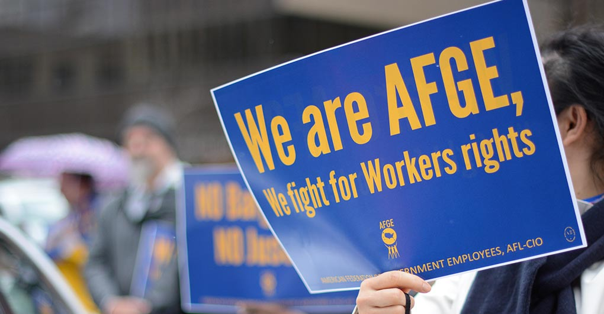
Join AFGE
Your Union Makes the Difference
Notes:
We will have more updates on our continuing effort to get better pay and benefits, and to improve our lives at work. Again, we want to keep you constantly informed. Please be sure you are signed up for updates through AFGE Action Network and AFGE Text, and that you gave your current home email and cell phone number on the sign-in sheet. This is a good start, brothers and sisters! Give yourselves a hand for all of you who joined us today and for taking the first step in improving our jobs!

