Slide 1

AFGE Local XXXX Worker Organizing and Empowerment Executive Order 14025
FOR MORE INFORMATION CONTACT: XXXX@GMAIL.COM

Slide 2
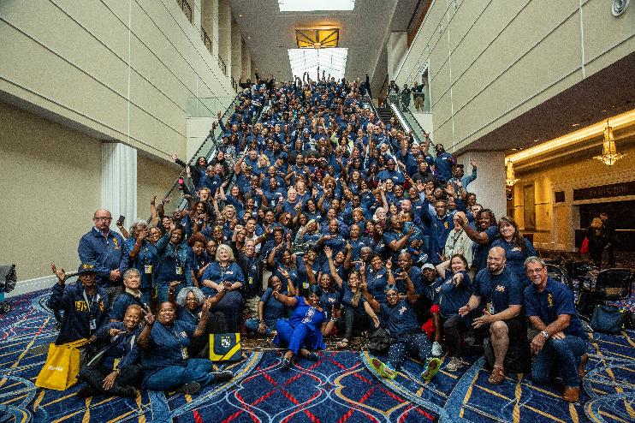
Welcome!
We are AFGE Local XXXX
This is YOUR union.
Contact XXXX with any questions.

Slide 3
Stay Connected
Get email and text updates sent to your phone.
Visit afge.org/GetConnected to sign up for email & text alerts!
Notes:
You can stay connected with your union, AFGE, by getting email and text alerts! There are a lot of changes happening quickly, and you need to be kept up-to-date and involved. Please visit the link I’ve dropped in the chat, afge.org/GetConnected and click “I would like to sign up for email and text alerts”

Slide 4

Notes:
We’re at the brink of changes that will make the federal government the most pro-employee it has ever been. With the wind on our back after the most recent OPM memoranda, we need to act NOW to use this guidance and fortify federal employee’s voices at work. During this presentation we will discuss the recent attacks on our rights, AFGE’s involvement in the creation of the Worker Organizing and Empowerment Executive Order and its implementation, and how we can utilize our Power NOW!

Slide 5
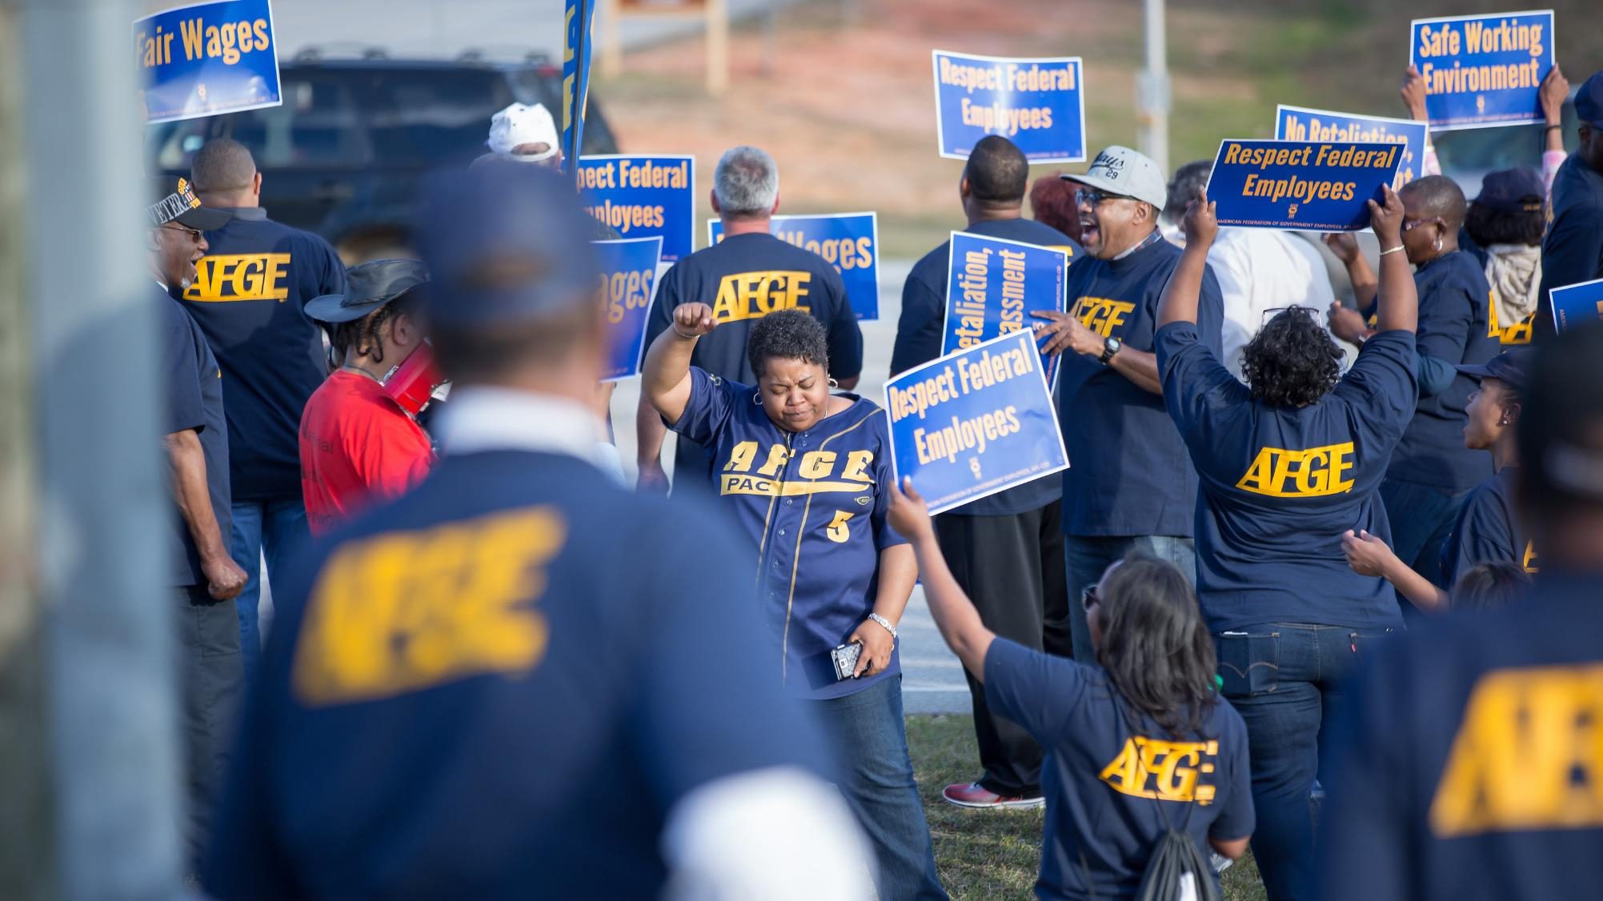
Recent Attacks on Our Rights
Notes:
We need to highlight recent attacks on government employees before we discuss our huge win for AFGE and federal workers.
Some of you may have seen the impact of the Trump anti-worker Executive Orders which limited telework, reduced representational rights, evicted unions from on-site offices, attempted to throw out our contracts and imposed management mandates that wiped out our workplace rights. Not only that, but it also decreased our power and voice at work which threatened AFGE’s existence.

Slide 6
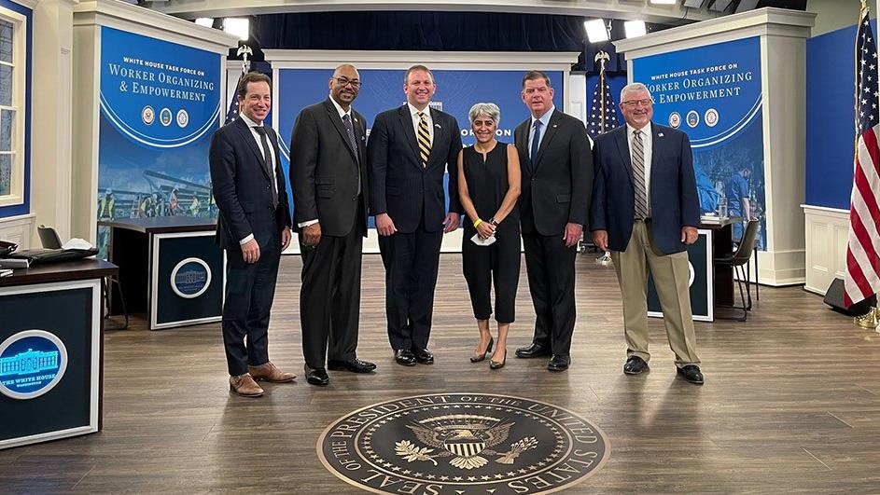
AFGE’s involvement in the creation of the Worker Organizing and Empowerment Executive Order 14025
Notes:
Mobilizing for Power is the life blood of AFGE. We rely on a network of activists at the Local level to have conversations with their co-workers, neighbors, and communities about the importance of dignity, equality, and respect on the job. Because of our mobilizing success, the Biden administration’s transition team reached out to AFGE to solicit pro-worker policy proposals.
When the Biden administration reached out to AFGE, our AFGE 2020 membership survey had already captured what was most important to federal workers. The first priority from our members was to rescind the Trump anti-worker Executive Orders which Biden did on his second full day in office. The second priority was to increase workers power to organize, mobilize and bargain collectively. Members who participated in our 2020 survey had their voices directly heard by the new administration. That is why it is so important to take our surveys, answer our calls to action when we email, and make your voices heard when we text you to reach out to your elected representatives.
The Biden Administration then signed the Worker Organizing and Empowerment Executive Order that formed a Task Force led by VP Harris and comprised of top agency officials, to empower workers to organize and promote collective bargaining. In President Biden’s own words, the public sector should be the “role model” employer. Something AFGE has always been fighting to achieve.
The time, sweat, and some tears AFGE leaders and activists experienced during our mobilizing efforts to rightfully reclaim our place at the table is the only reason we were able to take these day-to-day issues that are important to all of us directly to the Biden administration. We demanded our voices to be heard by standing in solidarity to create meaningful change in the workplace and we are seeing those changes take place NOW because of you!

Slide 7
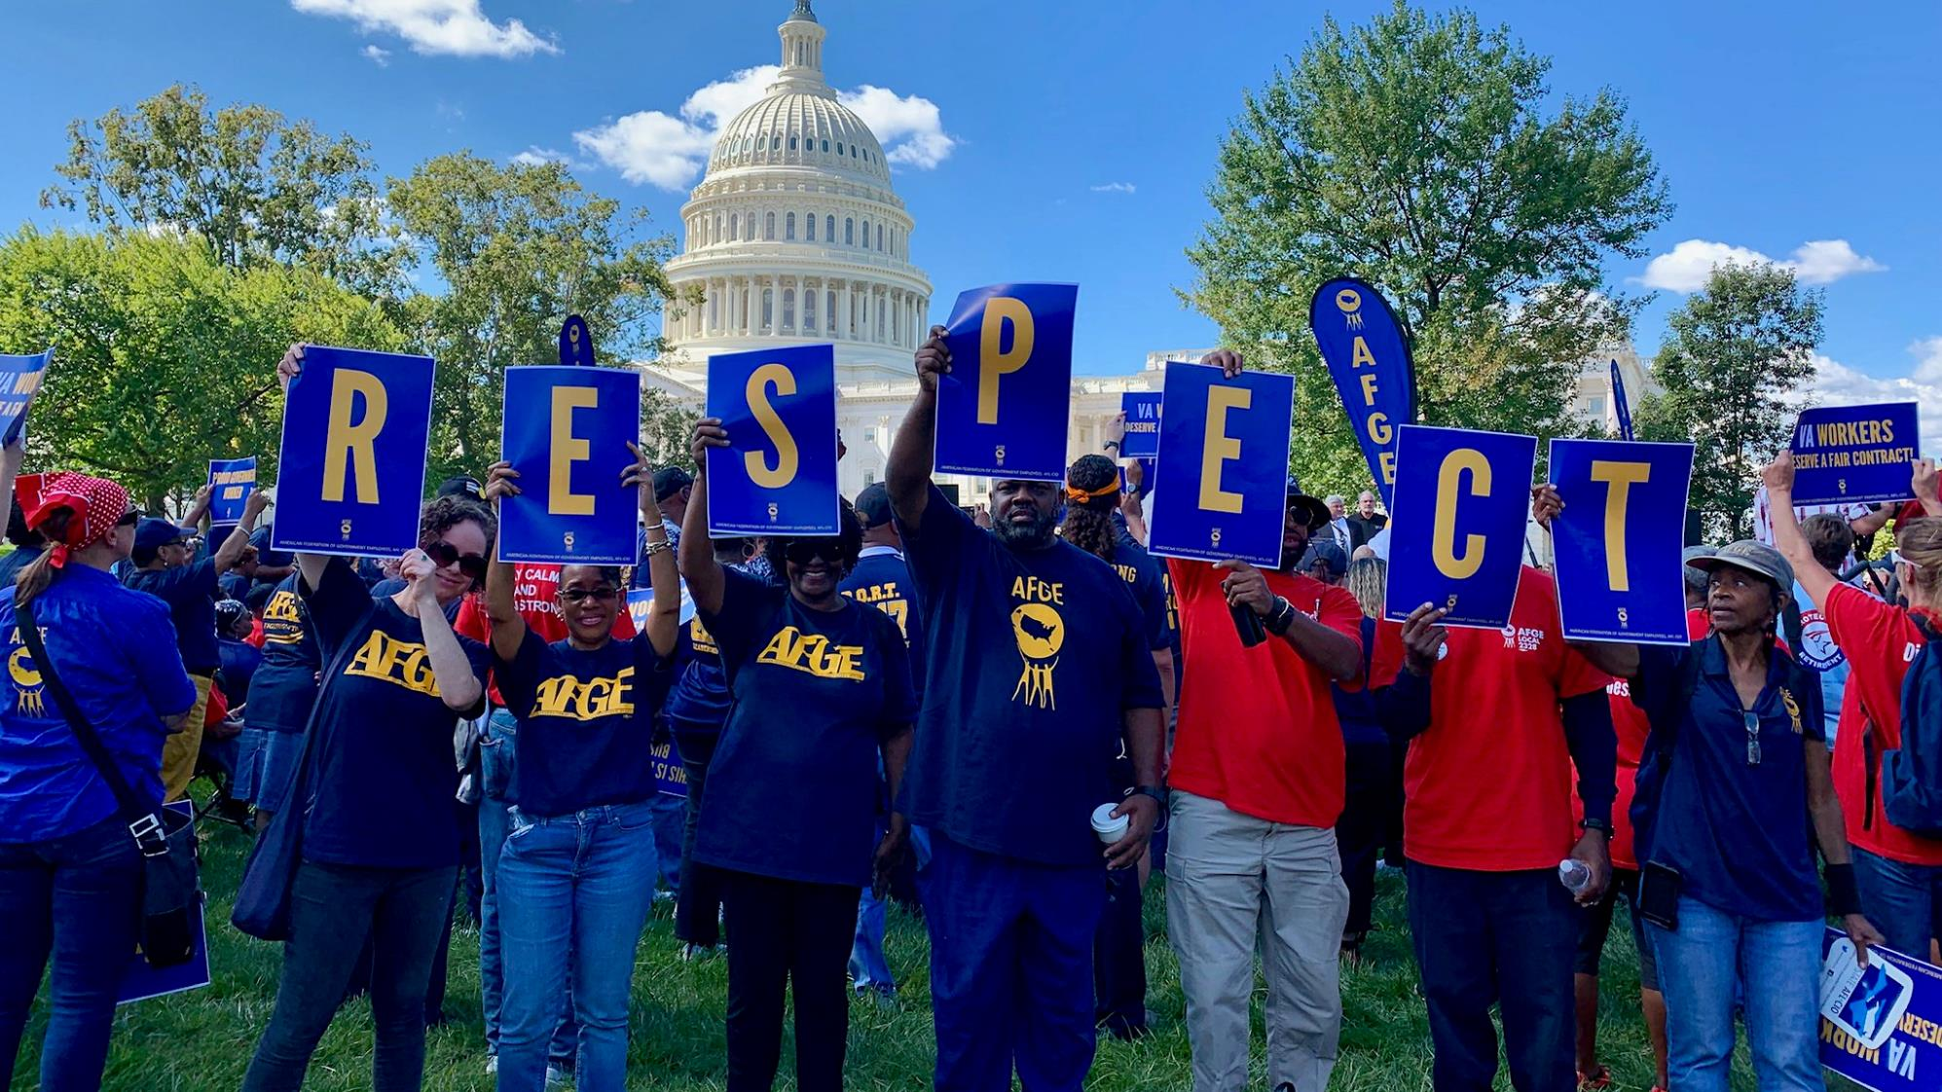
What does the Worker Organizing and Empowerment Executive Order Do and Why is it Important?
Notes:
As a result of the Task Force’s recommendations, OPM released the following directives:
First, all job announcements will include whether the position is a bargaining unit position. If so, it will also include the union’s name and its local number. With union membership at an all time low, only 10.8% of workers in the US are union members, a public sector job may be the first time a worker will have an opportunity to have union job. Including the bargaining unit status, the union’s name, and local number in the job posting will help introduce potential workers to unions.
Second, it directs agencies to include unions in New Employee Orientations. Once again, after decades of union-busting in the public and private sector, many workers are unaware of the importance of unions. This will guarantee that AFGE will have a fair opportunity to introduce the labor movement to new employees before they begin their career in the public sector. We need all Locals to be proactive by using their power to organize new employees NOW!
Finally, it directs agencies to include employee rights under the Federal Service Labor-Management Relations Statute 5 U.S.C. Chapter 71 during NEOs, again on a quarterly or bi-annual basis, and must include the union’s contact. Some BUEs and AFGE members may be well-educated about their rights, but some have only heard about their rights during a NEO while many may not know their rights at all. By including the union’s contact in all notifications of employee rights, it will ensure that all BUEs will be able to contact their union if they believe that any of their rights have been violated.
While these measures may seem simple, or while some agencies may have many of these processes already in place, it emphasizes federal employees have the right to organize, form and join unions NOW!

Slide 8
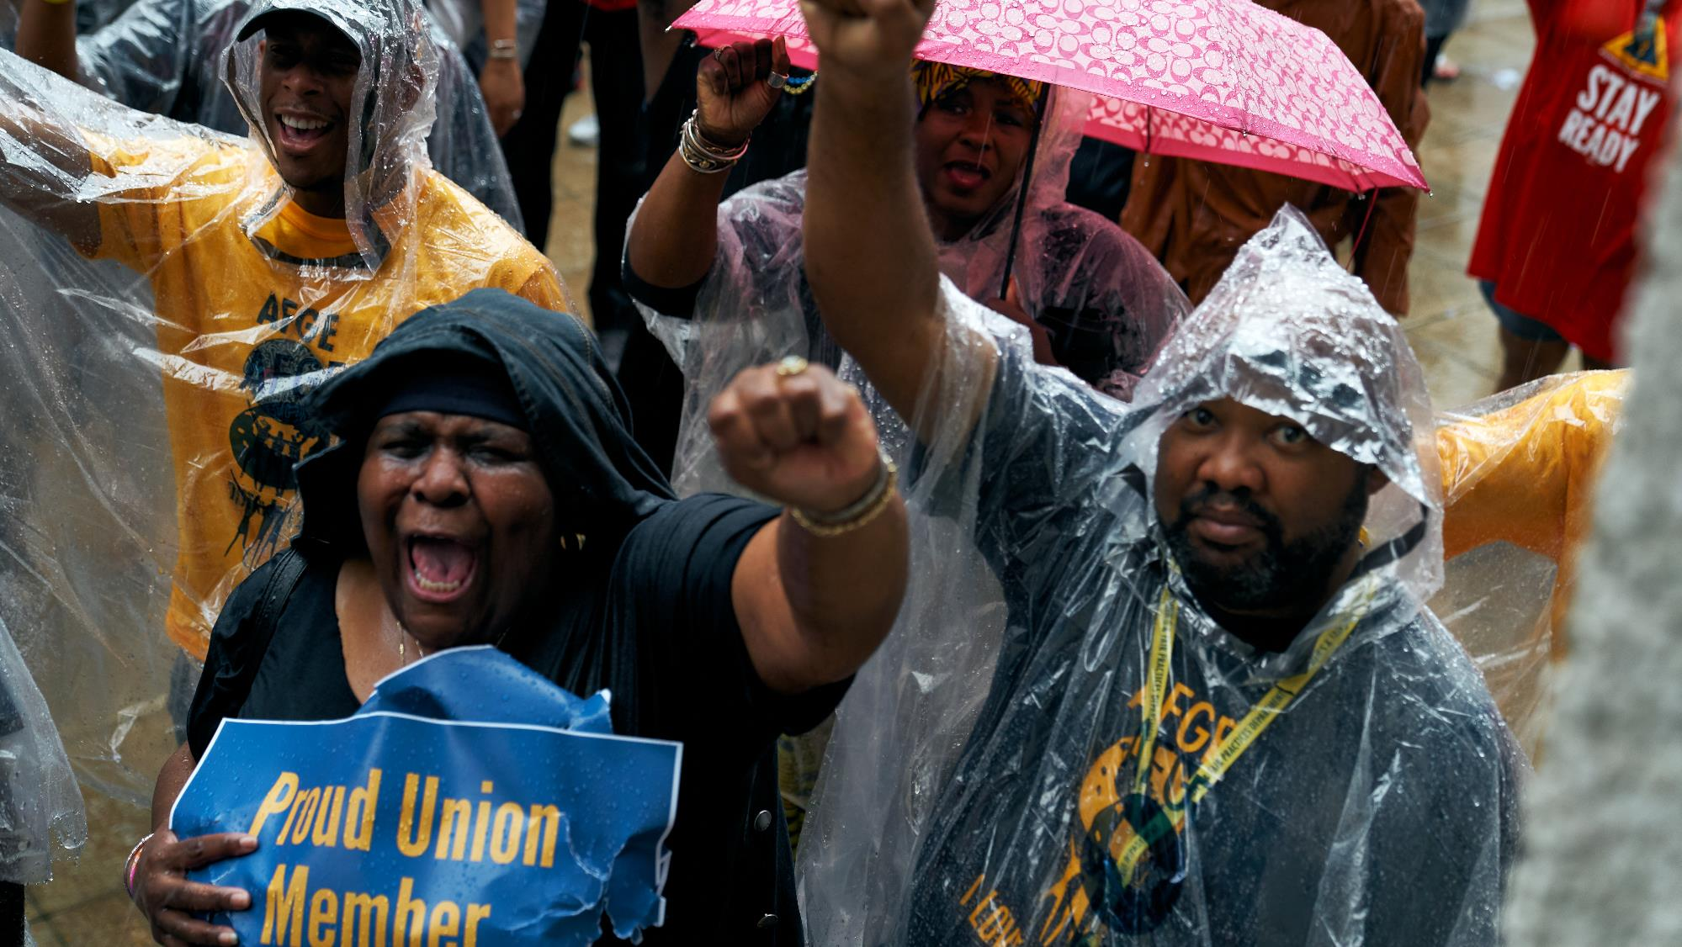
We Must Act NOW
Notes:
While the new guidance coming out of OPM is positive, to make the most of the changes it will require involvement from all of us. If what we talked about today excites you, you’re not alone. Right NOW, we can make impactful, positive changes for federal workers like yourselves and the government for generations to come. If you’ve been thinking about becoming an active member of AFGE, NOW is the time.
With this guidance, the administration aims to promote worker organizing and I’m here to tell you exactly how you can get involved in that organizing.
First, if you aren’t already a dues paying member, I ask you join now. Second, there are a multitude of ways to get involved with the union. If you’re interested in talking to your coworkers about the importance of union membership and activism join our organizing committee. If you would like to mobilize young workers around working-class issues join YOUNG. If you’re interested in promoting and acting on a legislative agenda that puts federal employees at the forefront, become a Legislative political coordinator. If you’re a veteran and want to focus on issues that effect veterans like yourself, join AFGE Veterans. Our Local is only as strong as we make it. The folks involved in all levels of the Local union are your coworkers and we can’t do it alone.

Slide 9
QUESTIONS?
Join AFGE
Your Union Makes the Difference
Notes:
So, we need you to sign up now. We need to join and build for power. To join AFGE you can fill out an 1187 that is included in the chat and return it to your local. You can also sign-up using E-dues with the link in the chat.
[While volunteers help people sign up, answer questions]
We should note that using just one or two of the AFGE member benefits can cover the cost of your annual dues.
Let me take any questions you might have. If you have any questions I can’t answer, I will write them down and get you an answer. I would like everyone to write their email in the chat, and I will get these answers to you.
[Take questions. If you need to time to obtain answer, please tell them you will get back to them]

Slide 10
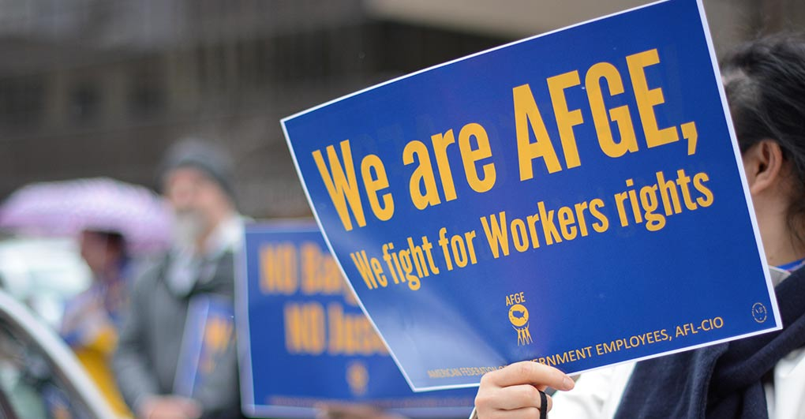
Join AFGE
Your Union Makes the Difference
Notes:
We are expecting more updates from OPM in the response to the EO that will have positive change in workplace. Again, we want to keep you constantly informed. Please be sure you are signed up for updates through AFGE Action Network and AFGE Text, and that you gave your current home email and cell phone number on the sign-in sheet. This is a good start! Give yourselves a hand for all of you who joined us today and for taking the first step in improving our jobs!

