Slide 1



Afge pay Raises
LOCAL #
Notes:
Hello all, please sign in as you enter. Thank you for joining us today. If you are not yet a member, please take a blank membership form with the you. We will be getting started shortly.

Slide 2


biggest pay raise in 40 years
OUR UNION
IS RAISING OUR PAY
locality pay raise for 32,900 feds
tsa employees get biggest pay raise in
history of federal government
Notes:
Welcome to our Local’s presentation on new pay raises in AFGE. We are thrilled to have you here. We will be talking about some of the victories we have had as a union of federal employees working together. The way we have made the gains we have are by working together as a Union. It has been thousands of federal workers, shoulder to shoulder, making these wins. Members filling out bargaining surveys, members lobbying on the Hill, making calls, signing petitions, joining together in real numbers. This union is your union, and our wins are your wins. The more we grow, the more power we have, and the bigger our future victories will be. Keep in mind, it has been federal employees working together that have won every single item we are going to discuss today.

Slide 3

Stay Connected
Get email and text updates sent to your phone.
Text ‘AFGE’ to 59129 to start receiving text alerts.
Visit afge.org/update to sign up for email alerts!
Notes:
And stay on top of our wins and keep plugged in to the effort to win more. You can stay connected with your union, AFGE, by getting email and text alerts! There are a lot of changes happening quickly, and you need to be kept up-to-date and involved. Please visit the link I’ve dropped in the chat, afge.org/update and click “I would like to sign up for email and text alerts” or text “AFGE” to 59129 to sign up for text alerts now.

Slide 4


5.2%
WORKING HARD WITH CONGRESS AND THE ADMINISTRATION, AND ENGAGING IN MEMBER DRIVEN LOBBYING, AFGE MEMBERS EARNED THE BIGGEST PAY RAISE IN OVER 40 YEARS
LOBBYING
CALLS TO CONGRESS
LETTER WRITING
Notes:
The 5.2% pay raise for federal employees is in the President’s 2024 budget. Not only would this be the largest increase since 1980, it would also be a significant step in the right direction for efforts to recruit and retain the next generation of federal worker. Let there be no doubt how we got here- AFGE members stood shoulder-to-shoulder, lobbying for the increase. At their local representatives offices in their congressional districts, and on the hill. Calls to congress, and letter writing. Each and every call, letter and office visit by and on behalf of the 700,000 federal employees covered by AFGE made the difference.

Slide 5
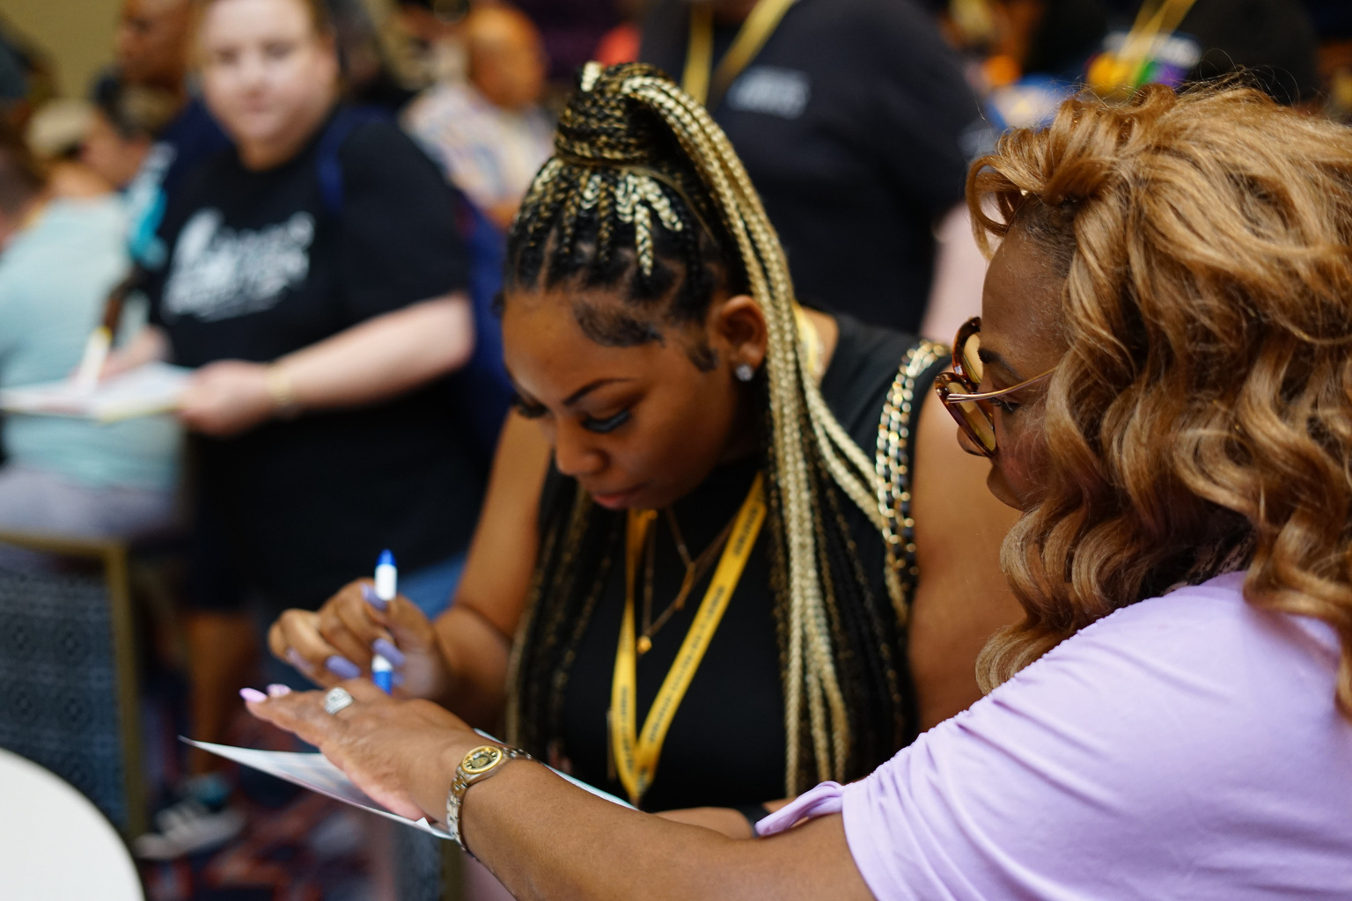
OUR
WORK
MADE
THE
RAISE
HAPPEN
Notes:
Our union is our members, and we got our raise because thousands of us made our voice heard and demanded a fair pay increase. This is the result of our Union’s hard work- members calling the hill, writing letters, our members, leaders and staff lobbying and building relationships over years to lay the groundwork for this win. The more we grow, the more members we have, the more people that get involved, the better we do when we push for pay raises. Our Union is fighting for better pay and winning.
no other groups are. If you aren’t a member yet, it is time to invest in better pay and join and become active.
And think of this? Who fought to get pay raises for federal employees? What group is advocating, making calls, knocking on doors, rallying for better pay? Can you think of any other interest group? Any other organization? The answer is “no.” It is us and only us.
If you only remember idea from this meeting, let it be this: we, as a Union, are the only group fighting for better pay. Nobody else is fighting for us. Nobody else is looking out for our interests, its just us. And we are winning.

Slide 6
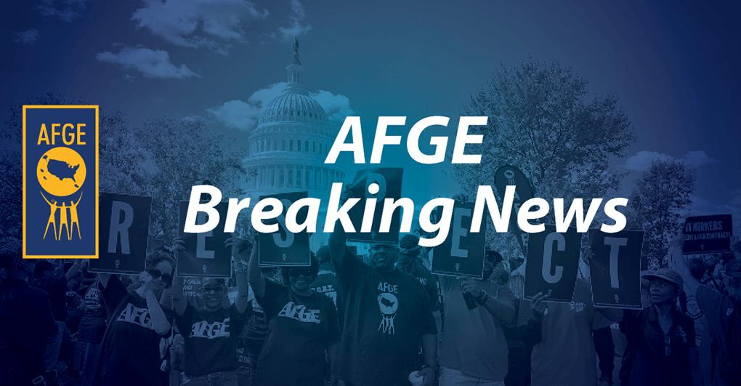
STAFFING THE FEDERAL SALARY COUNCIL, AFGE GOT A PAY RAISE FOR 32,900 FEDERAL EMPLOYEES JUST LAST YEAR. AFGE IS THE REASON THIS HAPPENED.
Notes:
AFGE is on the Federal Salary Council because we represent so many engaged and involved federal employees. On that Council, we proposed federal employees working in Fresno, Calif., Reno, Nev., Rochester, New York, and Spokane, Wash get a locality pay raise next year. We made the recommendation and pushed for the President to adopt it, and thanks to our activism and shared influence, he did. Now, the Office of Personnel Management is taking the final steps to implement the new General Schedule (GS) pay localities.
New counties will also be added to 43 existing localities, so those working and living in these counties will get a locality pay bump as well.
The changes mean about 32,900 federal workers will see a locality pay raise starting Jan. 1, 2024. Who did this? AFGE members did.

Slide 7






TSA PAY RAISE
BIGGEST IN HISTORY
$13,000
28%
AVERAGE ANNUAL RAISE
AVERAGE INCREASE
Notes:
Together, as a Union, we have gotten record breaking increases for our members in the TSA. We are looking at a 28% pay raise on average. If there is any doubt why we got it, realize that we got more union rights and pay in one pull. Who won this raise? We did, together, acting like a union. In a Washington Post Article titled “Airport screeners get big boost in pay and collective bargaining rights,” the newspaper writes, “The 28 percent hike is the largest federal pay bump in at least 30 years and probably ever, according to the federal Office of Personnel Management.” The article explains that “the average officer will receive a 28 percent pay raise, about a $13,000 annual boost, beginning in July. The increase is even fatter with federal locality pay.” 28% on average, $13,000 on average. Think about what that change means for you, for your family? Think about your experience with TSA, and whether they would choose to give you a raise and more rights on the job without being forced? Its clear we won this the old-fashioned way, as a Union. We won this together and should all join together in our Union to keep growing our power!

Slide 8
EVERY INCREASE
WAS BECUASE OF
MEMBER ACTIVISM
JOIN TODAY
  The MORE MEMBERS we have THE MORE POWER WE HAVE
  OUR PRIORITIES ARE YOUR PRIORITIES- MAKE YOUR VOICE HEARD
WORKING TOGETHER
WE IMPROVE OUR JOBS AND OUR PAY
Notes:
The fact of the matter is that every increase we have seen was because we, as union members, are active in our union. Working together we improve our jobs and our pay. AFGE is your Union. You should join your union today. It makes a difference: the more members we have, the more power we have. Added to that, our priorities are your priorities. Make your voice heard in your union for the things you cared about.

Slide 9
QUESTIONS?
Join AFGE
Your Union Makes the Difference
Notes:
So, we need to sign up now. We need to join and build for power.
[While volunteers help people sign up, answer questions]
We should note that using just one or two of the AFGE member can cover the cost of your annual dues.
Let me take any questions you might have. If you have any questions I can’t answer, I will write them down and get you an answer. I would like everyone to write their email in the chat, and I will get these answers to you.
[Take questions. If you need to time to obtain answer, please tell them you will get back to them]

Slide 10
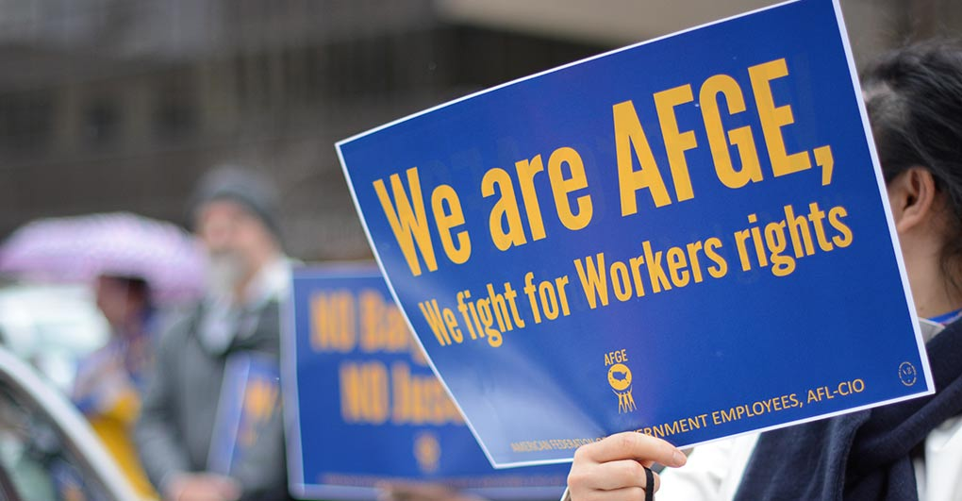
Join AFGE
Your Union Makes the Difference
Notes:
We will have more updates on our continuing effort to get better pay and benefits, and to improve our lives at work. Again, we want to keep you constantly informed. Please be sure you are signed up for updates through AFGE Action Network and AFGE Text, and that you gave your current home email and cell phone number on the sign-in sheet. This is a good start, brothers and sisters! Give yourselves a hand for all of you who joined us today and for taking the first step in improving our jobs!

