Slide 1
AFGE Local: HUGE Pay Increase for TSOs
FOR MORE INFORMATION CONTACT: XXXX@GMAIL.COM
Notes:
Hello all, please sign in as you enter. Thank you for joining us today. If you are not yet a member, please take a blank 1158 with you. We will be getting started shortly.

Slide 2
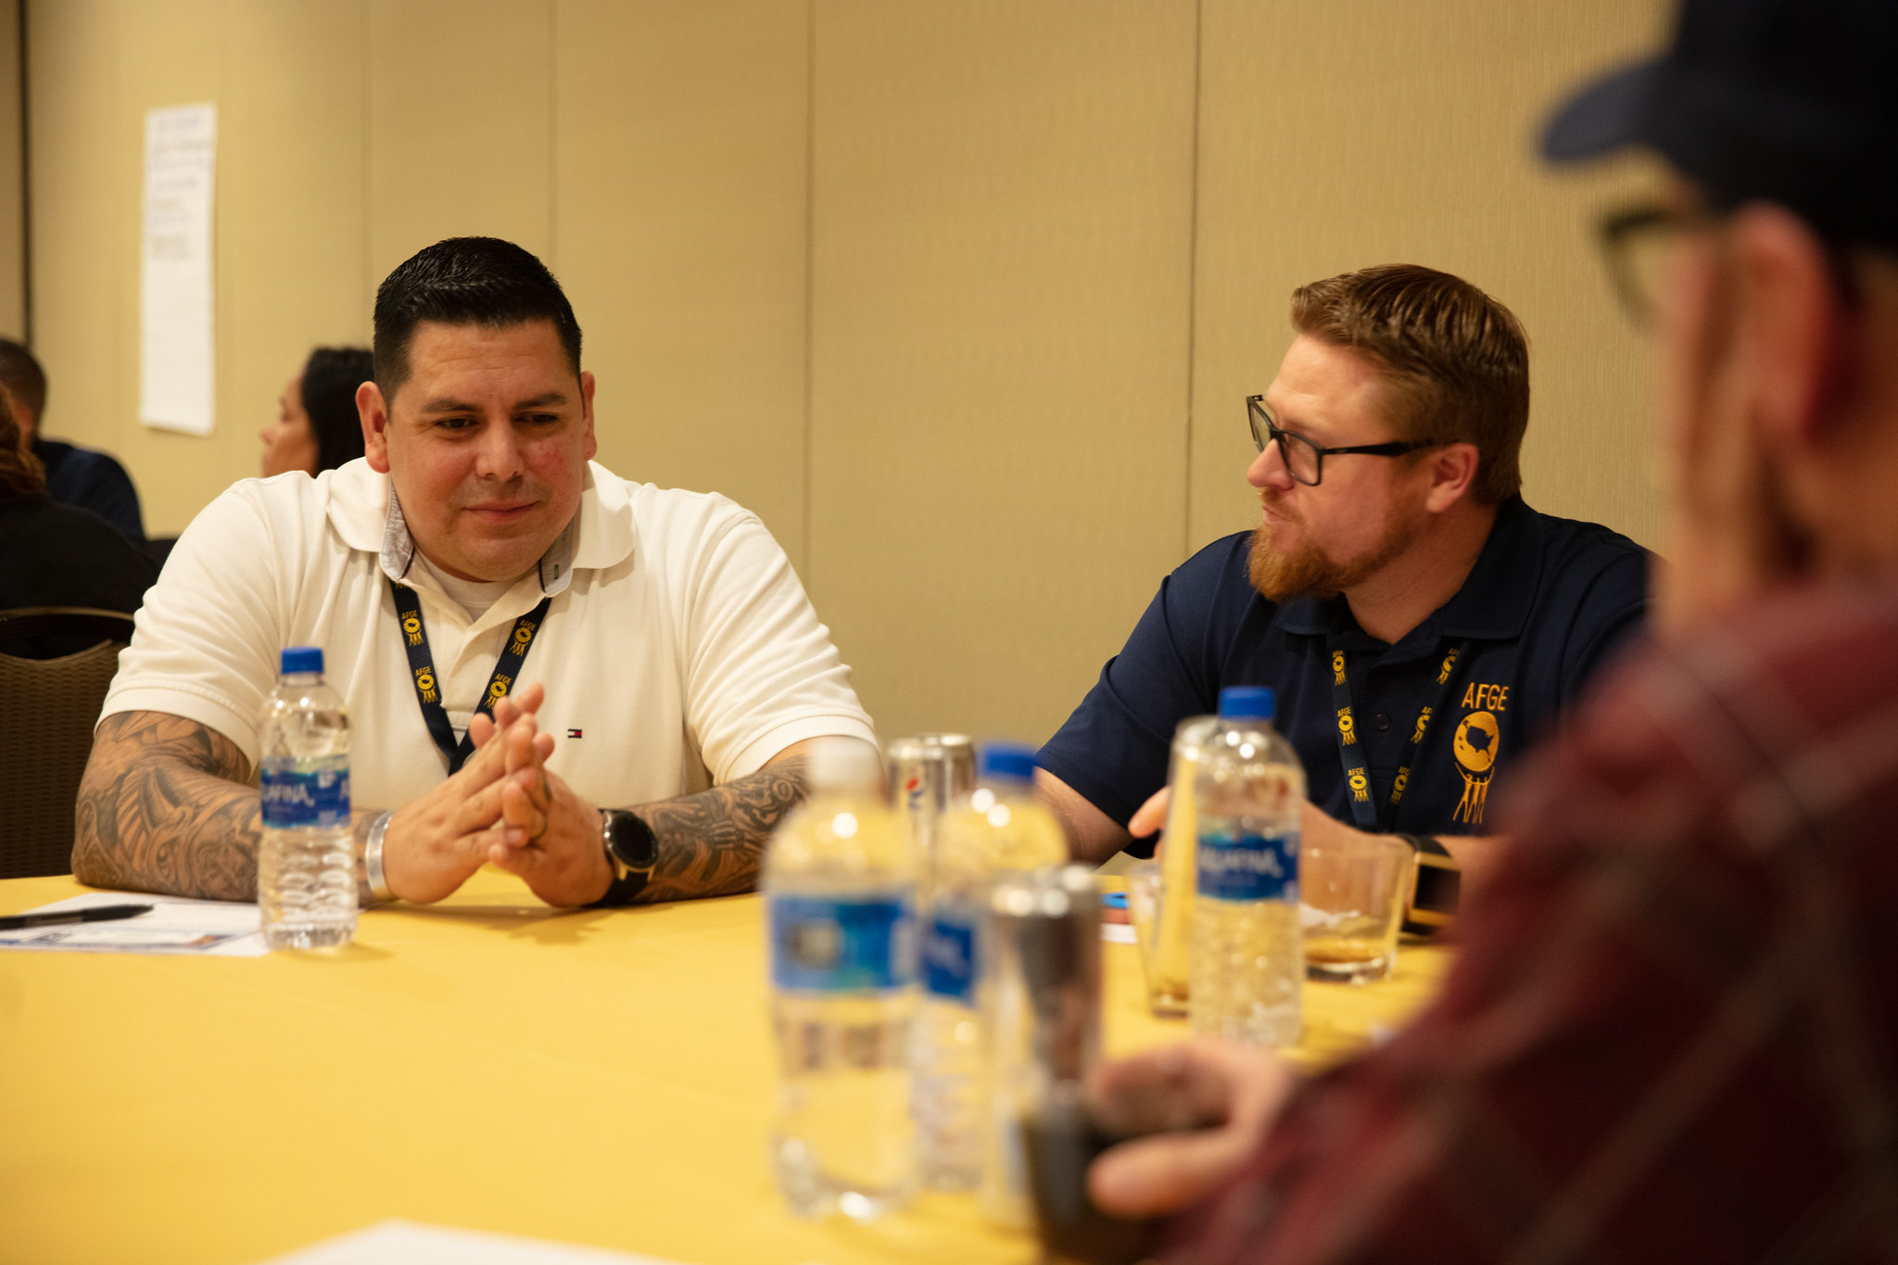
Welcome!
We are AFGE Local XXXX
This is YOUR union.
Contact XXXX with any questions.
Notes:
Welcome to our Local’s presentation on new pay raises for TSOs. We are thrilled to have you here. We will be talking about some of the victories we have had as a union of TSA employees working together. The way we have made the gains we have are by working together as a Union. It has been tens of thousands of TSA workers, shoulder to shoulder, making these wins. Members filling out bargaining surveys, members lobbying on the Hill, making calls, signing petitions, joining together in real numbers. This union is your union, and our wins our your wins. The more we grow, the more power we have, and the bigger our future victories will be. Keep in mind, it has been TSA employees working together that have won every single item we are going to discuss today.

Slide 3
Stay Connected
Get email and text updates sent to your phone.
Text ‘AFGE’ to 97779 to start receiving text alerts.
Visit afge.org/update to sign up for email alerts!
Notes:
And stay on top of our wins and keep plugged in to the effort to win more. You can stay connected with your union, AFGE, by getting email and text alerts! There are a lot of changes happening quickly, and you need to be kept up-to-date and involved. Please visit the link I’ve dropped in the chat, afge.org/update and click “I would like to sign up for email and text alerts” or text “AFGE” to 97779 to sign up for text alerts now.

Slide 4
WE WON!
Notes:
Years of hard work as a Union have paid off, your union, AFGE, recently persuaded TSA to make substantial improvements in TSO pay. These are the three most significant improvements made as a result of our work with the Administration:

Slide 5
28% PAY INCREASE
“The 28 percent hike is the largest federal pay bump in at least 30 years and probably ever, according to the federal Office of Personnel Management.”
Joe Davidson, January 6, 2023, “Airport screeners get big boost in pay and collective bargaining rights,” The Washington Post.
Notes:
Together, as a Union, we have gotten both increased rights on the job and a pay raise. We are looking at a 28% pay raise. If there is any doubt why we got it, realize that we got more union rights and pay in one pull. Who won this raise? We did, together, acting like a union. In a Washington Post Article titled “Airport screeners get big boost in pay and collective bargaining rights,” the newspaper writes, “The 28 percent hike is the largest federal pay bump in at least 30 years and probably ever, according to the federal Office of Personnel Management.”

Slide 6
28% PAY INCREASE
“the average officer will receive a 28 percent pay raise, about a $13,000 annual boost, beginning in July. The increase is even fatter with federal locality pay.
Joe Davidson, January 6, 2023, “Airport screeners get big boost in pay and collective bargaining rights,” The Washington Post.
Notes:
The article explains that “the average officer will receive a 28 percent pay raise, about a $13,000 annual boost, beginning in July. The increase is even fatter with federal locality pay.” Think about what that change means for you, for your family? Think about your experience with TSA, and whether they would choose to give you a raise and more rights on the job without being forced? Its clear we won this the old-fashioned way, as a Union. We won this together and should all join together in our Union to keep growing our power!

Slide 7
Grade level increase for all TSOs
Current Pay Band | Average Percentage Base Pay Increase
E | 30%
F | 26%
G | 31%
Entire TSO Workforce (E, F, and G bands) | 30%
*David P. Pekoske, Letter to Bennie Thompson, Chairman Committee on Homeland Security, January 19, 2022
Notes:
Looking at the Grade level increase for all TSOs: AFGE achieved an overall increase in the full performance level for non-supervisory TSOs from TSO pay band E to TSO pay band F. This is a full two-grade GS-level equivalent increase from GS-7 to GS-9.
This increase in pay will align the TSA pay band system to the GS-level equivalent for TSOs. Under the prior TSA pay band system, each pay band applicable to TSOs “shorted” employees by using starting pay levels that were less that the GS-level equivalents. For instance, TSO pay band E, which is supposed to be equivalent to GS-7, starts at 14% less than the GS equivalent level. As a union, we persuaded TSA to align the TSA pay band system to match GS-level equivalencies resulting in a significant increase in pay for TSOs.
Again- take time to think what an increase like this will mean for you and your family?

Slide 8
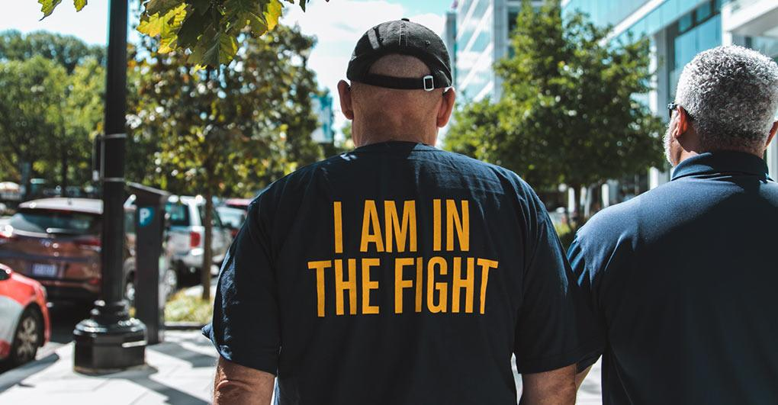
How did we do it? Together!
Your Union Makes the Difference
Notes:
This is the result of our Union’s hard work- members calling the hill, writing letters, our members, leaders and staff lobbying and building relationships over years to lay the groundwork for this win. The more we grow, the more members we have, the more people that get involved, the better we do when we push for pay raises. Our Union is fighting for better pay and winning.
no other groups are. If you aren’t a member yet, it is time to invest in better pay and join and become active.
And think of this? Who fought to get pay raises for TSOs? What group is advocating, making calls, knocking on doors, rallying for better pay? Can you think of any other interest group? Any other organization? The answer is “no.” It is us and only us.
If you only remember idea from this meeting, let it be this: we, as a Union, are the only group fighting for better pay. Nobody else is fighting for us. Nobody else is looking out for our interests, its just us. And we are winning.

Slide 9
To win better pay and rights, build your union.
Join AFGE
Your Union Makes the Difference
Notes:
Ask yourself, do you want to add your voice to 49,000 workers fighting to protect and improve our jobs at TSA? If the answer is yes, raise your hand.
Keep them up. Your coworkers are coming to help you sign up.
Joining today is the only way to have a voice at work. It is the only way to fight for better pay and rights on the job.

Slide 10
QUESTIONS?
Join AFGE
Your Union Makes the Difference
Notes:
So, we need to sign up now. We need to join and build for power.
[While volunteers help people sign up, answer questions]
We should note that using just one or two of the AFGE member can cover the cost of your annual dues.
Let me take any questions you might have. If you have any questions I can’t answer, I will write them down and get you an answer. I would like everyone to write their email in the chat, and I will get these answers to you.
[Take questions. If you need to time to obtain answer, please tell them you will get back to them]

Slide 11
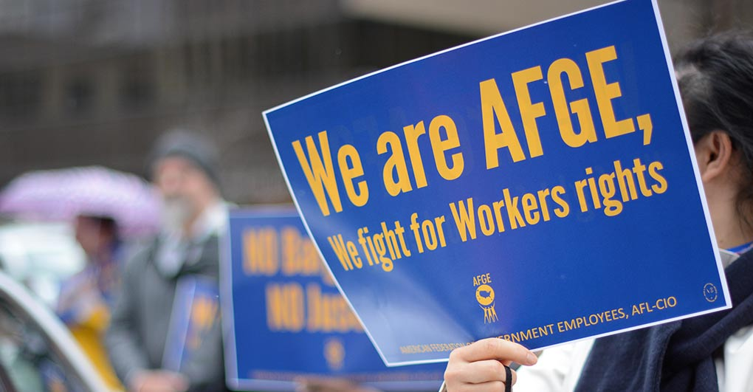
Join AFGE
Your Union Makes the Difference
Notes:
We will have more updates on our continuing effort to get better pay and benefits, and to improve our lives at work. Again, we want to keep you constantly informed. Please be sure you are signed up for updates through AFGE Action Network and AFGE Text, and that you gave your current home email and cell phone number on the sign-in sheet. This is a good start, brothers and sisters! Give yourselves a hand for all of you who joined us today and for taking the first step in improving our jobs!

